Slide 1
BEPS Philippine Scenario
By Euney Marie J. Mata-Perez
Managing Partner, Mata-Perez& Francisco

Slide 2
Philippine Scenario
No clear rules
BIR issuances are revenue driven
BIR issuances have been challenged in courts

Slide 3
Tax Code
Section 50 –
Authorizes the Commissioner of Internal Revenue to place a controlled taxpayer on a tax parity with uncontrolled taxpayer
CIR is authorized to distribute, apportion and allocate income items and deductions
Note: No power to impute (CIR v. Filinvest)

Slide 4
Transfer Pricing Regulations
Promulgated in January 2013
Aligned with OECD guidelines – arm’s length standard
Adopts OECD methods (CUP, RPM, CPM PSM and TNMM)
Not fully implemented; no clear precedents yet
APA regulations still to be promulgated

Slide 5
Permanent Establishment/Source Rules
Airline Decisions – Issuance of the ticket is the activity which produces the income. (Note: airlines have no landing rights)
Crucial in determining source of income and status of taxpayer (resident v. non-resident)
Recent CTA decision: the activity which produced the income is the undertaking of providing satellite communication time.

Slide 6
Recent Withholding Taxes Regulations
Submission of proof of exemption
Higher disclosure requirements
  Administratively difficult to comply
  Could violate data secrecy and bank secrecy rules
  TRO issued by the Supreme Court

Slide 7
Anti-Treaty Shopping Provisions
BIR: Requires the filing of tax treaty relief application before each transaction
Supreme Court: Tax treaty obligations take precedence over revenue regulations

Slide 8
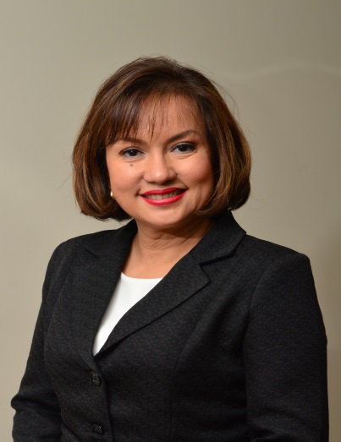
Euney Marie J. Mata-Perez is a CPA-lawyer and is the managing partner of Mata-Perez & Francisco. She has more than 21 years of experience of handling various aspects of tax, corporate and special projects practice. She is a past president of the Tax Management Association of the Philippines and has been identified as one of the leading tax practitioners and corporate lawyer in the Philippines.
ejmata-perez@mpfcounsels.com

