Slide 1

AOTCA Taipei Meeting 2014
Destination-based Consumption Taxation
for Digital Services based on
Proposals of the Japanese Government
Yoshihiko Nakanishi
ZEIRISHI, Certified Public Tax Accountant
Member, International Relations Department, JFCPTAA
Friday, October 24, 2014
© JAPAN FEDERATION OF CERTIFIED PUBLIC TAX ACCOUNTANTS’ ASSOCIATIONS

Slide 2
1. Introduction
International e-commerce through the Internet is expanding.
The cross-border markets for digital content in Japan is estimated to be at US$5,119,000,000 as of 2012.
The Japanese government seeks new approaches to consumption taxation regarding cross-border e-commerce.
Source: Materials prepared by Makoto Yonekawa for the Tax Commission, April 4, 2014
 | Cross-border markets for digital content Estimate value (Unit: mil. USD, USD1=\100) | Share
Internet Advertising | 2,668 | 52.1％
e-books | 352 | 6.9％
Cloud computing | 1,482 | 29.0％
Music | 231 | 4.5％
Software | 133 | 2.6％
Movies | 105 | 2.1％
Games | 126 | 2.5％
Pay-based e-mail magazines | 22 | 0.4％
Total | 5,119 | 100.0％
© JAPAN FEDERATION OF CERTIFIED PUBLIC TAX ACCOUNTANTS’ ASSOCIATIONS
Notes:
VAT now operates in about 150 countries. VAT affects 4 billion people and represents 20% of the world’s tax revenue.
Continuing shift from direct taxation to indirect taxation

Slide 3
2-1. Developments in the OECD & EU
In 1998, the OECD’s Committee on Fiscal Affairs (CFA) endorsed Electric Commerce: (Ottawa) Taxation Framework Conditions.
Rules for the consumption taxation of cross-border trade should result in taxation in the jurisdiction where consumption takes place.
Where business and other organizations within a country acquire services and intangible property from suppliers outside the country, countries should examine the use of reverse charges, self-assessment, or other equivalent mechanisms where this would provide the immediate protection of their revenue base and of the competitiveness of domestic suppliers.
In 2003, the OECD Centre for Tax Policy and Administration endorsed Consumption Taxation of Cross-border Services and Intangible Property.
Identifying business presence in B2B transactions
Guidance on simplified registration regimes
Verification of customer status and jurisdiction
In 2014, the OECD published International VAT/GST Guidelines.
Neutrality of value-added taxes in the context of cross-border trade
Determining the place of taxation for cross-border supplies and intangibles (B2B)
Further discussions can be found in Addressing the Tax Challenges of the Digital Economy, OECD/G20 Base Erosion and Profit Shifting Project, a final report on September 16, 2014.
© JAPAN FEDERATION OF CERTIFIED PUBLIC TAX ACCOUNTANTS’ ASSOCIATIONS
Notes:
Background
Greater interaction of VAT systems
Growing risk of double taxation
Growing risk of unintended non-taxation
Distortion of cross-border trade, in particular, in services and intangibles
⇒ Demand for greater coherence of VAT systems and VAT rules

Slide 4
2-2. Developments in the OECD & EU
EC Directives
Council Directive 2002/38/EC (effective July 1, 2003)
Electronic services supplied for consumption outside of the European Union are exempted from VAT.
When supplied for consumption within the European Union, they are subject to EU VAT.
Non-EU operators benefit from simplified registration and reporting obligations, allowing them to deal with a single European tax administration of their choice.
VAT rules where non-EU suppliers selling to business customers in the European Union with the VAT paid by the importing company under the reverse charge arrangement
Council Directive 2006/210/EC
Extending the EC directive was to extend until December 31, 2009.
Council Directive 2008/8/EC
The rules introduced by Council Directive 2002/38/EC will be extended from January 1, 2010 as a permanent measure.
From January 1, 2015, VAT on telecommunications, radio & television broadcasting, and electronic services supplied by a supplier established within the community to non-taxable persons also established within the community will be charged in the Member State where the customer belongs (inclusion of these services in the “one-stop-shop” scheme).*
* Council Implementing Regulation (EU) No. 1042/2013
© JAPAN FEDERATION OF CERTIFIED PUBLIC TAX ACCOUNTANTS’ ASSOCIATIONS

Slide 5
3. VAT for Digital Services in the EU
Under the EC Directive, e-commerce, e.g., supplies of digital content such as e-books and music are all categorized as “supplies of services.” The rules of services are applicable to the place of taxation.
◆ B2B – Destination Principle
Place of taxation: Place of the recipient
Taxpayer: Supplier of service (in case of the reverse charge: Recipient of service)
◆ B2C – Origin Principle (Destination Principle, in part)
Place of taxation: Place of the supplier of service (some exceptions)
Taxpayer: Supplier of service
Exception 1: Extra-EU ⇒ Intra-EU
Exception 2: Intra-EU ⇒ Extra-EU
Place of taxation: Place of the recipient (Destination Principle)
The scheme does not currently apply to telecommunications or broadcasting services, but from Jan. 1, 2015 it will apply to these services.
Place of taxation: Place of the recipient (Destination Principle)
One-time VAT registration* (“mini one-stop shop” –MOSS) adopted in 2003; non-EU suppliers can make use of a simplified procedure that allows them only to register for VAT in one EU country, regardless of how many other EU countries they are supplying.
Under the present system, supplies of services within the EU are subject to tax at the location of the suppliers of services. If services are provided from a place located in a country with lower tax, the supplier can reduce VAT burden.
Example: Tax for e-books is at a reduced rate: 5.5% in France and 3% in Luxemburg. Companies having their main office located in Luxemburg can provide e-books within the EU at only 3% tax.
© JAPAN FEDERATION OF CERTIFIED PUBLIC TAX ACCOUNTANTS’ ASSOCIATIONS

Slide 6
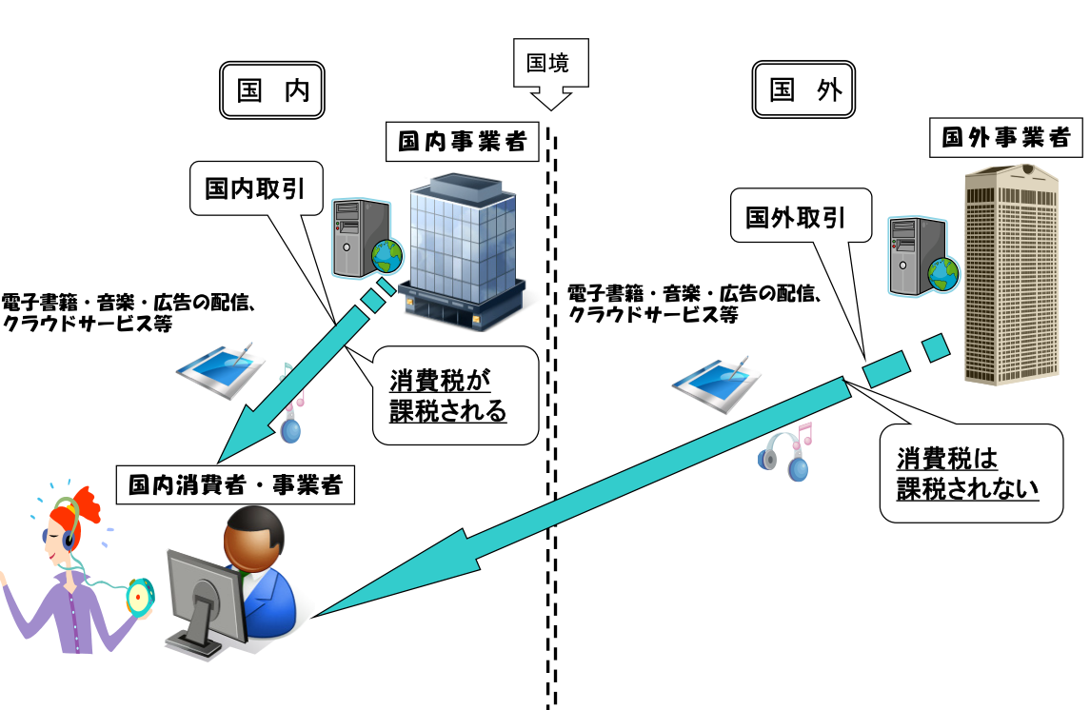
4-1. Japan’s Current Situation & Issues
Current consumption tax system for the cross-border supplies of services
Border
Domestic
Overseas
Foreign business
Domestic business
Domestic transaction
Overseas transaction
e-books, music, Internet ads, cloud computing, etc.
e-books, music, Internet ads, cloud computing, etc.
Consumption tax
No Consumption tax
Domestic consumer/business
Under the current Japanese consumption tax law, the determination of cross-border supplies of services regarded as domestic transactions depends on whether the place of the office of service suppliers is domestic or not. Thus, services by domestic suppliers are subject to consumption tax, however, services by overseas suppliers are not.
© JAPAN FEDERATION OF CERTIFIED PUBLIC TAX ACCOUNTANTS’ ASSOCIATIONS

Slide 7
4-2. Japan’s Current Situation & Issues
Necessity for system change
If the place of cross-border supplies of services is not clear, the place of taxation for such services is determined by the place of the service supplier’s office. Thus, the services for digital content, such as downloading an e-book, music, and Internet advertising provided by domestic businesses, are subject to consumption tax, whereas such services provided by foreign businesses are not subject to consumption tax. ⇒ Difference in suppliers, domestic or foreign, makes a difference in tax burden. ⇒ Distortion in the competitive condition between foreign and domestic suppliers arises.
In order to impose consumption tax on such overseas transactions, currently being not taxable, the change of the place of taxation rule is necessary for such transactions to be regarded as domestic ones.
The tax rules of the place of taxation for foreign suppliers must be changed.
© JAPAN FEDERATION OF CERTIFIED PUBLIC TAX ACCOUNTANTS’ ASSOCIATIONS

Slide 8
5-1. Proposals by Japan’s Ministry of
Finance
Change of place of taxation
1) Change to the Destination Principle
In terms of cross-border services provided by a foreign business*,
if the place of supply of services is not clear, the place of taxation
will be changed from the current “Place of the office of the supplier
of the service” to the “Location of the recipient of the services.”
Certain transactions, such as international transportation and international communications, are excluded.
* Foreign businesses: Sole entrepreneurs with no residence in Japan or corporations having no head office or no main office in Japan
© JAPAN FEDERATION OF CERTIFIED PUBLIC TAX ACCOUNTANTS’ ASSOCIATIONS

Slide 9

5-2. Proposals by Japan’s Ministry of Finance
Place of taxation
1)
Is the place of the service provision clear?
Place where the service is provided
Yes
2) Services designated by Cabinet Order
No
International transaction/communication/postal service | Insurance | Provision of info. on plant construction, etc.
Place of departure or destination | Place of the office of the insurance business operator concluding the insurance contract | Place where most of the materials for plant construction are procured
Is it included in the services designated by Cabinet Order?
Yes
No
3) Other than the above (e.g. cross-border supplies of services)
Supplies of digital content are often said to be ambiguous; that they should be categorized as supplies of services or sales/leases of assets as such.
Therefore, there needs to be a way to clarify that certain supplies of digital content are to be categorized as supplies of services, for consumption tax purposes.
Current: Place of the office of the Supplier of the service
Proposal: Location of the Recipient of the services
© JAPAN FEDERATION OF CERTIFIED PUBLIC TAX ACCOUNTANTS’ ASSOCIATIONS

Slide 10
5-3. Proposals by Japan’s Ministry of Finance
2) Clarification of transactions not subject to change concerning current taxation
If the supply of service is completed outside Japan in substance, such supply is to be treated as a foreign transaction—not subject to consumption tax. In order to address concerns from businesses that certain transactions might inadvertently be treated as domestic transactions—subject to consumption tax—the treatment of certain transactions expected to be foreign transactions is to be clarified under the law. This would be, for example:
Outsourcing the collection, digestion, and analysis of information relating to things outside of Japan, where such activities are performed outside Japan (including the delivery of the result from such activities); and
Provision of services in connection with the acquisition, management, or transfer of assets located outside Japan, where such activities are performed outside Japan (including the reporting of the results from such activities).
However, even if the provision of a service appears to have been completed outside Japan, the new principle on the place of taxation for cross-border supplies of services discussed in Slide 8 and 9 is to be applied where such services are provided as a package with a service provided in Japan.
Example: Cases where services are provided outside/inside Japan as a package
Provision of two kinds of services as a package upon request from a domestic business customer (i) outsourcing a system development performed outside Japan and (ii) installing systems at offices located in Japan
Provision of two kinds of services as a package upon request from a domestic business customer (i) outsourcing R&D activities performed outside Japan and (ii) the adoption of the result of R&D activities for product manufacturing conducted in Japan
© JAPAN FEDERATION OF CERTIFIED PUBLIC TAX ACCOUNTANTS’ ASSOCIATIONS
Notes:
再検討

Slide 11
6-1. Change of Tax Methods:
Two Methods of Taxation
Two Methods of Taxation
The supplies of services by foreign suppliers that will be newly categorized as domestic transactions due to the change in the principle of taxation will be subject to consumption tax.
The methods of taxation will defer to the characteristics of the services.
In case of “B2B supplies,” the reverse charge arrangement will be applied.
In case of “B2C supplies,” the foreign supplier filing system will be applied.
© JAPAN FEDERATION OF CERTIFIED PUBLIC TAX ACCOUNTANTS’ ASSOCIATIONS

Slide 12
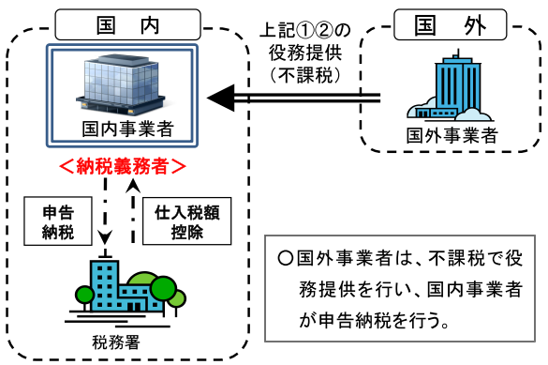
6-2. Change of Tax Methods:
Two Methods of Taxation
B2B supplies: Reverse charge arrangement
For B2B supplies, the obligation to self-access and pay output tax on B2B supplies will be imposed on domestic business customers under the reverse charge arrangement.
(i) Judging from the characteristics of B2B supplies as usual (Internet advertising, etc.).
(ii) Supplies to both consumers and businesses (crowd computing, etc.), clarified as to the business through the terms and conditions of the transactions
Domestic
Supplies of the services above (i) & (ii)
(no consumption tax)
Overseas
Domestic bus, consumer
Foreign supplier
Tax obligation
Payment
of tax
Input tax credit
Foreign suppliers provide services at no tax, while domestic business consumers are obliged to self-access and pay tax.
Tax office
© JAPAN FEDERATION OF CERTIFIED PUBLIC TAX ACCOUNTANTS’ ASSOCIATIONS

Slide 13
6-3. Change of Tax Methods:
Two Methods of Taxation
B2B supplies: Reverse charge arrangement
Definition of B2B supplies
“B2B supplies” is defined as the cross-border supply of services provided to a business, which is clarified as a business by nature or by the terms and conditions of the service, among supplies of services performed through telecommunications lines (Internet, telephones, etc.). Regarding the B2B supplies that a foreign business is providing, the duty to pay tax is changed to that of a domestic business.
Obligations imposed on foreign suppliers
A foreign supplier has the obligation to notify the service recipients that the services are subject to the reverse charge arrangement. The timing of the notification is to be further considered, taking into account the fairness of transaction terms between domestic and foreign businesses.
The method of taxation will not be affected by whether the foreign supplier makes proper notification or not.
Countermeasures related to administrative burden for domestic business customers
In order to minimize the incremental administrative burden due to the introduction of reverse charge arrangement, certain domestic business customers, such as, those whose taxable input ratio (the ratio of taxable inputs over the sum of taxable and non-taxable inputs) is greater than or equal to a certain threshold (e.g., 95%), are not required to apply the reverse charge arrangement for a certain period of time, on the assumption that the output tax on services subject to the reverse charge is the same as the creditable input tax on the services.
© JAPAN FEDERATION OF CERTIFIED PUBLIC TAX ACCOUNTANTS’ ASSOCIATIONS

Slide 14
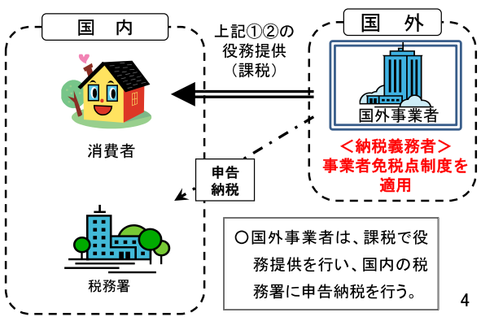
6-4. Change of Tax Methods: Two Methods of Taxation
B2C supplies: Foreign supplier filing system
The obligation to file a consumption tax return and pay consumption tax to the Japanese government is to be imposed on foreign suppliers in “B2C supplies.”
(i) Judging from the characteristics, B2C supplies as usual (downloading of e-books, music, etc.)
(ii) Supplies to both consumers and businesses (crowd computing, etc.), clarified supplies to businesses through the terms and conditions of the transactions
Domestic
Overseas
Supplies of services above (i) & (ii) (subject to consumption tax)
Foreign supplier
Domestic consumer
Tax obligation
Tax filing exemption for certain suppliers is applicable.
Tax filing
Foreign suppliers provide services at prices including tax and must file tax returns with the Japanese tax office.
＊Very similar to the “one-stop-shop” scheme.
Tax office
© JAPAN FEDERATION OF CERTIFIED PUBLIC TAX ACCOUNTANTS’ ASSOCIATIONS

Slide 15
6-5. Change of Tax Methods: Two Methods of Taxation
B2C supplies: Foreign supplier filing system
Definition of B2C supplies
B2C supplies are defined as cross-border supplies of services through telecommunication lines that are ambiguous regarding whether the recipients of the services are businesses by nature or regarding the terms and conditions of the services. For B2C supplies by foreign businesses, the foreign businesses are obliged to file consumption tax returns under the current law.
Filing obligations by foreign suppliers
The Japanese government aims to ensure that foreign suppliers fulfill their obligation to lodge consumption tax returns through cooperation with foreign tax authorities under cross-border information exchange agreements and treaties of assistance in the collection of taxes.
The current rules, which provide an exemption from filing a consumption tax return for certain suppliers, are to apply to foreign suppliers as well as domestic suppliers. Thus, foreign suppliers are generally only to be obliged to file consumption tax returns under the new rule if their taxable outputs in Japan are over 10 million yen in a taxable year.
Issues when domestic business customers receive services from foreign suppliers
Supposed domestic business customers receive B2C services from foreign suppliers (downloading of e-books, music, etc.), the foreign suppliers are obliged to file a consumption tax return and the domestic business customers may claim input tax credits, in general. However, the foreign suppliers have an offshore residence where the Japanese government has no jurisdiction over tax. There is a natural limit on Japanese tax administration regarding compliance for domestic and foreign taxpayers as per Japanese consumption tax laws. Subsequently, issues on "input tax credits without tax payment" might arise.
Thus, in the context to prevent these newly raised problems, which would hinder the fairness of taxation rules, the new proposals of the government will not allow an input tax credit for services provided by foreign suppliers to domestic business customers.
However, in terms of the services regarded as B2B in general but regarded as B2C (e.g., e-books, cloud computing, etc.) judged from the characteristics and terms of transactions, if it is clear that a certain transaction will be B2B due to the change in the terms of transactions, etc., afterward, the reverse charge arrangement will be applied to that transaction.
© JAPAN FEDERATION OF CERTIFIED PUBLIC TAX ACCOUNTANTS’ ASSOCIATIONS

Slide 16
7. Conclusion
In terms of the consumption tax treatment of the cross-border supply of services and intangibles, the Ministry of Finance has presented proposals to revise the current rules, taking into account technical views on determination criteria for businesses domestic and foreign, along with how and whom is to be taxed. These proposals have been made in view of the present status of e-commerce in Japan and the approaches in OECD and EU states. Basically, the proposals look similar to the system in the EU, i.e., the "one-stop-shop" scheme and the reverse charge arrangement.
However, the proposals have a characteristic feature regarding the categorization of B2B and B2C transactions. The definition of B2B transactions has been limitedly made for consumption tax purposes. B2B transactions that do not fall under that definition are, in principle, categorized as B2C, even though they are generally considered as B2B. In other words, blanket rules are imposed on legitimate businesses in fear of fraud or revenue losses.
In Japan, neither the registration system nor the credit invoice method are introduced for claiming input tax credits, but the account method does and is unique to Japan. The proposals focus mainly on control over claiming excessive input tax credits, as foreign suppliers are not covered by Japan’s taxing jurisdiction. The National Tax Agency has no enforcing power outside Japan. However, the proposals are extremely suitable for the current Japanese consumption tax practices of both the tax administration and taxpayers, which may be appreciated.
© JAPAN FEDERATION OF CERTIFIED PUBLIC TAX ACCOUNTANTS’ ASSOCIATIONS

Slide 17
8. Reference
Tax Commission of Japan, International Taxation Discussion Group, Consumption Tax Treatment of Cross-Border Supplies of Services, July 6, 2014
KPMG Tax Corporation, KPMG Japan tax newsletter, Report on “Consumption Tax Treatment of Cross-Border Supplies of Services and Intangibles”, November 20, 2013
KPMG Tax Corporation, KPMG Japan tax newsletter, Consumption Tax Treatment of Cross-Border Supplies of Services, July 8, 2014
OECD, Global Forum on VAT, International VAT/GST Guidelines, April 17 and 18, 2014
European Commission, Report of the Commission Expert Group on Taxation of the Digital Economy, March 28, 2014
European Commission, Explanatory notes on the EU VAT changes to the place of supply of telecommunications, broadcasting and electronic services that enter into force in 2015 (Council Implementing Regulation (EU) No. 1042/2013),
April 3, 2014
© JAPAN FEDERATION OF CERTIFIED PUBLIC TAX ACCOUNTANTS’ ASSOCIATIONS

