Slide 1
AOTCA INTERNATIONAL TAX CONFERENCE BEPS OVERVIEW
Ken Schurgott, The Tax Institute, Australia
Gil Levy, Honorary Advisor
23-24 October 2014, Regent Hotel Taipei

Slide 2
Overview of the role of the Technical Committee and the BEPS project.
The big issues:
Transfer Pricing and the digital economy
Permanent Establishment and digital presence
Permanent Establishment and agency arrangements.(see Diagram and agency arrangements in Country S)
Pricing Intangibles
Treaty Shopping
CFC rules

Slide 3
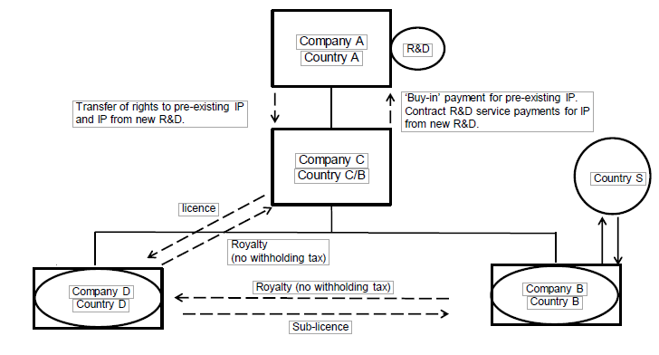
CFC Rules - U.S. and Australian Comparison

Slide 4
Facts
large number of R&D employees resident in U.S.
some marketing and administration employees in other companies
sale of IP Coy to Coy C plus cost contribution agreement for new Ip in return for part ownership
license IP to Coy D in return for Royalty
Coy D sub-licenses to Coy B
Coy B sells to customers outside

Slide 5
Cash from sales after staff costs goes back to Coy D as a royalty.
From D to C as a royalty.
C pays some out as contribution to R&D and keeps the rest.
Initial price for R&D funded by capital contribution Coy A to Coy C=cash neutral.

Slide 6
Tax
Not much profit left to tax in Coy B and only at Irelands 12.5% rate
Ireland is happy gets much more tax from employment taxes than company tax
Ireland prevented from levying withholding tax on royalty under EU interest and royalties directive.
Coy D’s royalty receipts offset by royalty payments to Coy C
No withholding tax on royalties in the Netherlands.
Easy to get ruling on small amount of profit left in the Netherlands.
No tax in Coy C in Bermuda

Slide 7
No tax paid in the U.S. on sales outside U.S.
Little tax paid on sale of I.P. –low value in early stages
Cost contribution means title to and risk for IP outside U.S rests with Coy C.
Therefore Coy A rewarded for new IP only on a cost plus basis.
Risk Stripping is one of the main features of transfer pricing planning giving rise to BEPS

Slide 8
Place of incorporation sole test of residence in U.S.
Income of Coy’s B, C and D foreign source non-resident.
To overcome many countries introduce CFC rules to tax resident shareholders controlling foreign companies on passive and related party income.
In Australia related party income is Tainted Sales and Services income.
U.S first to introduce CFC and generally regarded as toughest CFC in the world.
Why doesn’t CFC tax Company A in the U.S.?

Slide 9
U.S “check the box rules” make companies D and B transparent. We call them hybrids,
The only company recognised is Coy C and it is deriving active sales income from unrelated customers which is not subject to the U.S. CFC regime.
Australia was going to follow suite with amendments to our CFC regime but they were permanently deferred under the new Liberal Govt.
Problem for repatriation funds as dividends in U.S because little foreign tax credit.
Australia no problem as non-portfolio dividends from related companies exempt at the corporate level.

Slide 10
© Ken Schurgott & Gil Levy
Disclaimer: The material and opinions in this paper are those of the author and not those of The Tax Institute. The Tax Institute did not review the contents of this presentation and does not have any view as to its accuracy. The material and opinions in the paper should not be used or treated as professional advice and readers should rely on their own enquiries in making any decisions concerning their own interests.

