Slide 1




“BEPS and GAAR developments in Taiwan”
Dr.Stefan Huang, Shih Chou
Tax-Accountancy Association Union, Chinese Taipei
Associate Professor, National Taipei University of Business
Ulaanbaatar, Mongolia, 2018

Slide 2

Curriculum Vitae
│Educational Background│
‧LLM and jur. Phd of National Taiwan University, College of Law
‧regular Visiting Scholar of International Tax Center Heidelberg Uni, International Tax Center of Max Planck Institute Munich.
│Work Experience│
Tax Attorney at PwC Taipei Office
Assistant Professor, Associate Professor, Dean of Faculty of Tax Administration of NTUB 2014-2017
Lecturer at Judge’s Academy, Finance Academy, IRS, Bar Association, CPA Association.
Member of IFA Taipei, Deutsche Steuerjurist Gesellschaft
│Expertise│
‧Tax Litigation and Tax Planning
‧International Taxation and Practice
│Journal Column│
Economic Daily, Tax Journal Magazine
│Publish│
Burden of Proof in Tax Litigation, Case Study on Tax Litigation
Introduction of BEPS and Taxation on E-commerce, etc and 100+ articles
Dr. Shih Chou, Huang Asso. Professor
Faculty of Tax Admin.
National Taipei University of Business
+8862 23226385
+886920711411
 shanehua@ntub.edu.tw

Slide 3

BEPS and Corporate Tax Regulation Changes in Taiwan
  Thin-Capital Regime
  CbC Reporting
  CFC and PEM Regime
BEPS and Cross-Border E-Commerce
  Simplified VAT Regime
  Taiwan’s EC Situation
  EC’s VAT compliance and E-Invoicing
  Simplified Corporate Tax Regime
GAARs in Taiwan
  Regulatory Background: Substance over Form Clause
  Case 1: Uber VAT Case
  Case 2: Triangle Trade and PEM
Conclusion: Low Profile and Pre-Consulting with Tax Authorities
Content of Presentation
02

Slide 4
Beginning from the year 2011, excess interest shall not be considered as expense or loss if the proportion of related party debt to equity of a company exceeds a specified ratio.
    Related Parties
    Debt-Equity ratio is 3:1
If the thin-capital is met, the interest expense over 3:1 ratio shall be excluded.
Financial institutions are excluded from the application of Thin-Capital Regulation.
BEPS and CIT in Taiwan: “Thin-Capital Regulation”
01

Slide 5
Taiwan has implemented the three tiered TP documentation system . Multinational enterprises meet criteria shall report CbC, master file and local files.
Threshold for filing CbC report is 750 million Euros of yearly revenues beginning from the fiscal year of 2017. First CbC reporting shall be submitted in May 2018(Taiwan’s tax season).
Even if a in Taiwan registered subsidiary of the MNE is exempted from CbC reporting, Taiwan tax authorities might request its parent company for CbC report.
Master file reporting has a threshold of NTD 3 billion(100 million USD) of revenue or NTD 1.5 billion(50 million USD) cross border controlled transactions.
Taiwan’s BEPS development: “CbC Reporting”
02

Slide 6
Requirements for Controlled Foreign Company Taxation:
    directly or indirectly holding 50% of a foreign company.
    The controlled foreign company incorporated in “low-tax” jurisdiction-effective CIT rate below 14%.
    Earning of the fiscal year not exceeding 7 million NTD(230,000 USD)
    The controlled foreign company has no substantial activities
2. criterion for “substantial activities”
    Office and employees; and
    Passive income below 10% of revenue.
3. CFC Regime has enacted in 2016 but not be effective yet!!!
Taiwan’s BEPS development: “CFC Regime”
03

Slide 7
Requirements for Place of Effective Management Taxation:
    The significant decisions in business management, financial management, and personnel management is made by Taiwanese individuals or company.
    Financial statements, records of accounting books, minutes of meetings of the Board of Directors or minutes of meetings of the shareholders prepared or stored in Taiwan
    Major business activities carried out in Taiwan.
2. If PEM requirements meet: the foreign company will be deemed as domestic company and shall file and pay CIT per Taiwanese tax laws.
3. The same as CFC Regime, PEM Regime has enacted in 2016 but not be effective yet!!!
Taiwan’s BEPS development: “PEM Regime”
03

Slide 8
  Starting from 1 May 2017.
  Applicable only to :
    sales of digital services to domestic consumer. (Sales of physical goods via digital platform are subject to low value exemption.)
    Foreign enterprise, which has no PE in Taiwan but conducts cross-border sales of electronic services to local consumers.
  Cross-border EC-Platform shall be the VAT taxpayer and liable to VAT for sales of digital services.
  Registration Threshold: annually sales of NT480,000 (US16,000)
  Tax compliance (return filing and payment) shall be conducted on a bimonthly basis.
BEPS and Cross-Border E-Commerce: simplified VAT Regime
03

Slide 9
  E-Commerce Business registered
    88 business registered (end of Aug 2018)
    All Big Digital Players are onboard: Netflix(NL), Agoda(SG), E-bay(CH), Google Asia(SG), Expedia(SG), Valve(US), Apple Distribution(IE), Amazon(US, LU, JP), Alibaba(SG), Uber(NL), Facebook(IE) Airbnb(IE).
    Nationalities of registered business:
      Ireland, USA, Singapore, Netherland, Switzerland, Japan and others.
      Taiwan has tax treaties with NL, SG and CH.
  VAT Revenue from cross-border digital sales:
  Scale of Sales:
    3 billion USD(2018 expected), and would result into
    150 million USD in VAT collectible(VAT rate 5%).
BEPS and Cross-Border E-Commerce: Taiwan’s EC Situation
03

Slide 10
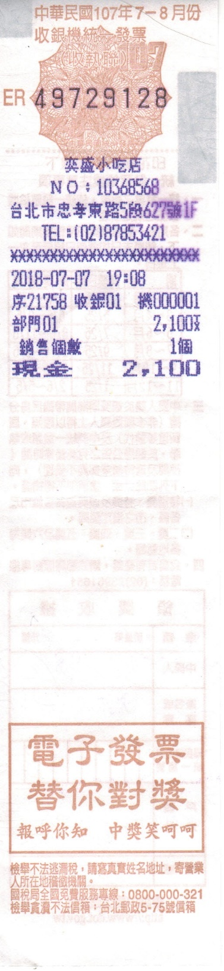
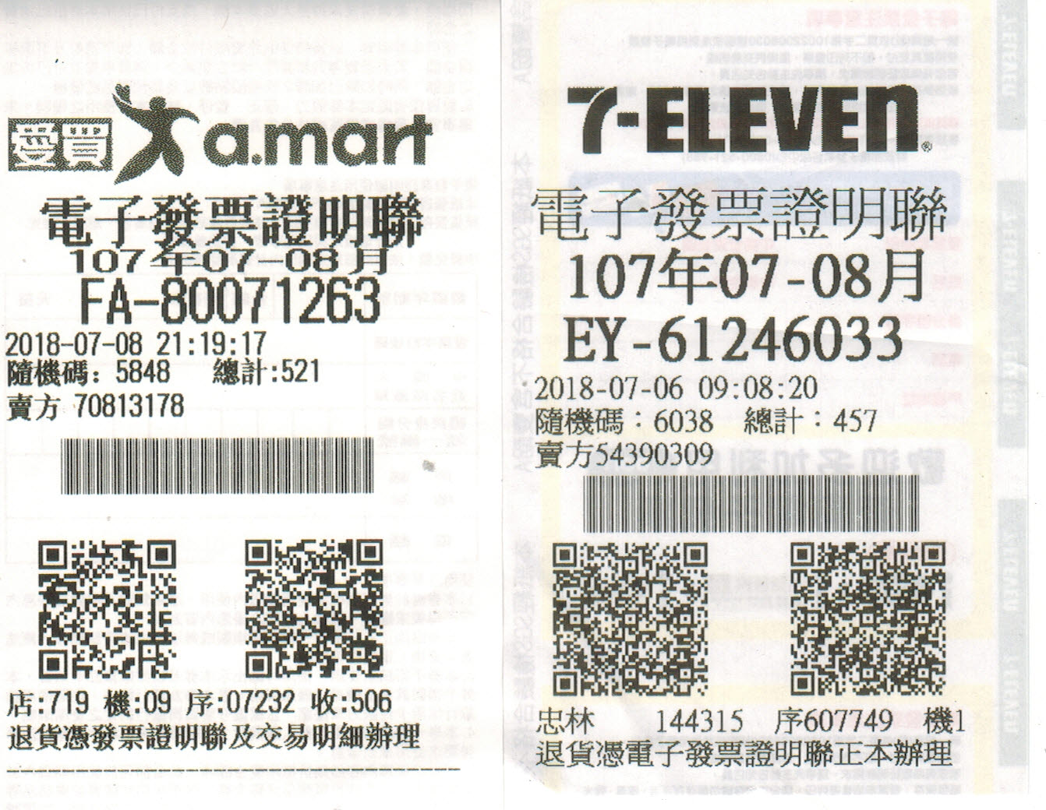
EC’s VAT compliance and E-Invoicing
B2C E-Invoice is mounting-> 7 billion in 2017
VAT Invoices shall be issued in all B2C transactions.
Cross-border EC shall issuing Electronic Invoice to consumers from 1.1.2019.
03

Slide 11
Each VAT Invoice is with “identical serial number”.-2 digits English+8 digits Arabic numbers.
  Ex. FF-63845805
Identical serial numbers for B2C Invoice may win VAT lottery!
3% of VAT revenue goes to lottery. Lottery Awards from NT 200 to 10 million (6Euro- 300.000 Euro). Only 3-4‰ chance to wine NT200.
Consumers are apt to donate VAT Invoice for charity.
*Enterprise issuing E-Invoice bears the responsibilities to notify consumer of lottery awards! Otherwise it is liable for damages.
Taiwan’s B2C VAT Lottery
03

Slide 12
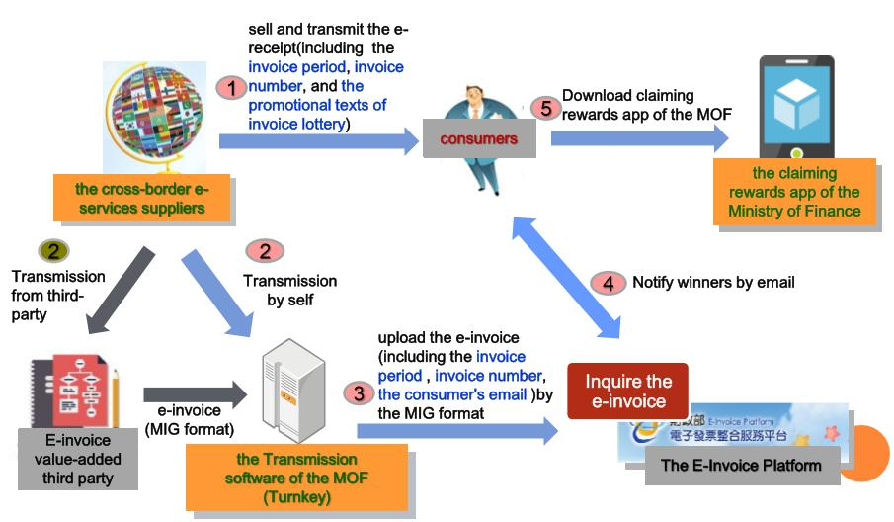
MOF E-Invoice Platform& Procedure

Slide 13
  Before 2009: Constitutional Interpretation recognized “Substance over Form” as legal principle applicable to taxation.
  Since 2009: Article 12-1 of Tax Collection Act has regulated, Substance over Form principle shall be applicable in following three situations:
    when tax authorities are interpreting tax laws;
    when tax authorities are reviewing the tax related fact. In such case, the tax liabilities shall be assessed in accordance of economic reality.
    when taxpayer is abusing the right to transactions and property arrangement. In such case, the tax liabilities shall be adjusted in accordance of regular transaction.
  * Tax authorities shall be the burden of proof while adopting Substance over Form rule.
GAARs in Taiwan: Regulatory Background(1)
03

Slide 14
  From the end of 2017, the Taxpayers’ Right Protection Act is effective.
  Article 7 further regulates the application of GAAR/Substance over Form rule:
    Reiterate the Substance over Form for tax law interpretation and fact finding.
    Define the elements of tax avoidance:
      Abuse the legal form
      Irregular transaction
      Acquired economic benefit but waived tax liabilities.
    In case of tax avoidance, tax liabilities shall be assessed in accordance with regular transaction and economic reality.
    Tax avoidance shall not be treated as tax evasion and only subject to a surcharge of 15% tax.
    In case of taxpayer withholding substantial tax facts from the tax authorities, the tax avoidance will be treated as tax evasion and further subject to tax penalty.
    Taxpayer may request tax authorities for tax ruling for the intended transaction.
GAARs in Taiwan: Regulatory Background(2)
03

Slide 15
    From 2013-2016, Uber BV(NL) was regarded to conduct transport service to Taiwanese consumers with the assistance of locally established “Uber Taiwan” a 100% owned subsidiary.
      Uber Taiwan provided only the so called “non-core” functions such as drivers recruiting, marketing and public relationship.
      Uber Taiwan only received cost reimbursement from Uber BV monthly.
      Contract, cash flow and drivers dispatch were all handled by Uber BV via online platform.
    Tax authorities applied the “substance over form” principle(“GAAR”) to deem the Uber Taiwan shall be responsible for the related VAT.
    Uber Taiwan was assessed with NT 50 million VAT payable plus 1.5 times of tax penalty.
    The case was decided against Uber Taiwan in first instance but penalty was repealed by supreme administrative court. Though the arrangement of Uber was regarded as “tax avoidance”(artificially to avoid the PE constitution), it shall be treated differently from tax evasion on the ideas of Taxpayers’ Right Protection Act.
GAAR Case 1: Uber VAT Case
03

Slide 16
    A Co. is incorporated in Taiwan and has set up a 100% owned paper company in BVI. A Co. was doing business with its clients in China and USA. A Co’s business activities like purchase, order, OEM and payments were mostly handled under the name and OBU accounts of BVI paper company. The business profits arising therefrom were all stored in the OBU accounts of BVI paper company.
    In Taiwan’s tax authorities’ perspective: Though the contracts signed, service and goods delivered and payments made were under the BVI company’s name, all its management and decisions were done by A Co’s officials. The BVI paper company was effectively managed as a nominee of A Co. The business profits should be deemed as A Co’s taxable business income. Therefore, A Co was assessed 400.000 USD in corporate tax payable and further subject to tax evasion penalty.
GAAR Case 2: Triangle Trade and PEM
03

Slide 17
    Question of this case:
      Taiwan’s PEM regime is not effective yet! Tax authorities bypassed PEM regime through GAAR!
      When PEM is applicable, in principle, it won’t result in tax penalty…. But this case was deemed as tax evasion through GAAR application.
GAAR Case 2: Triangle Trade and PEM
03

Slide 18
    GAAR applications in Taiwan can bypass a lot of requirements laid down by tax laws. This tax law practice has increased much legal risk in tax planning. The solutions could be:
      Keep your business in low profile (vs the high-profiling Uber)
      When implementing new structures, shall be very aware of potential legal risk.
      Consult the tax authorities in first place if you concern the potential legal risk.
Conclusion
03

