Slide 1
Tax Advisers as Pillars of Tax Payers'Rights
Jiri Nekovar Adviser of AOTCA, Adviser of CFE Czech Republic
Ulaanbaatar, Mongolia, 2018

Slide 2
Presentation Outline
BEPS and It’s Influence on Tax Payers’ Rights
Tax Advisers as a Tax Payers’ Rights Guarantee
Tax Adviser Organizations in Europe
Experiences from the Work of Czech Tax Advisers
The Mission of Tax Advisers
01

Slide 3
A. BEPS and It’s Influence on Tax Payers’ Rights
Strengthening of legislature against tax optimization in both member and non-member OECD countries after implementing the conclusions of BEPS 2015
The tax administration gains strength, it’s subjective deliberation process becomes more influential, especially in the relationship to evaluating the intent of the tax payer, if their behavior does not conflict with the intention of the tax legislation
Tax is a business cost as any other for businesses, with the difference of it being set by law
Every prudent business strives for lowering costs of their operations
Tax optimization, working to maintain tax costs at a level optimal for the entirety of the economic operation, is often seen in conflict with tax laws
02

Slide 4
B. Tax Advisers as a Tax Payers’ Rights Guarantee
Tax payers must increasingly be able to:
Navigate new tax laws
Understand new approaches of tax administrations
Be aware of new interpretation of current tax law
There is a greater need of evaluating possible tax risks before making major management decisions
For example, saving on taxes can no longer be the main motivation behind a managerial decision. It is questionable how large of a task risk it is when a rational managerial decision brings, among other things, tax savings.
Without highly qualified assistance of a tax adviser throughout the whole process, the tax payer leaves themselves vulnerable to unknown risks
03

Slide 5
C. 1. Tax Adviser Organizations in Europe
From the 27 European Union member states, specific legislature to regulate the tax advising profession exists in the following countries:
Austria
Croatia
Czech Republic
Germany
Poland
Romania
Slovakia
04

Slide 6
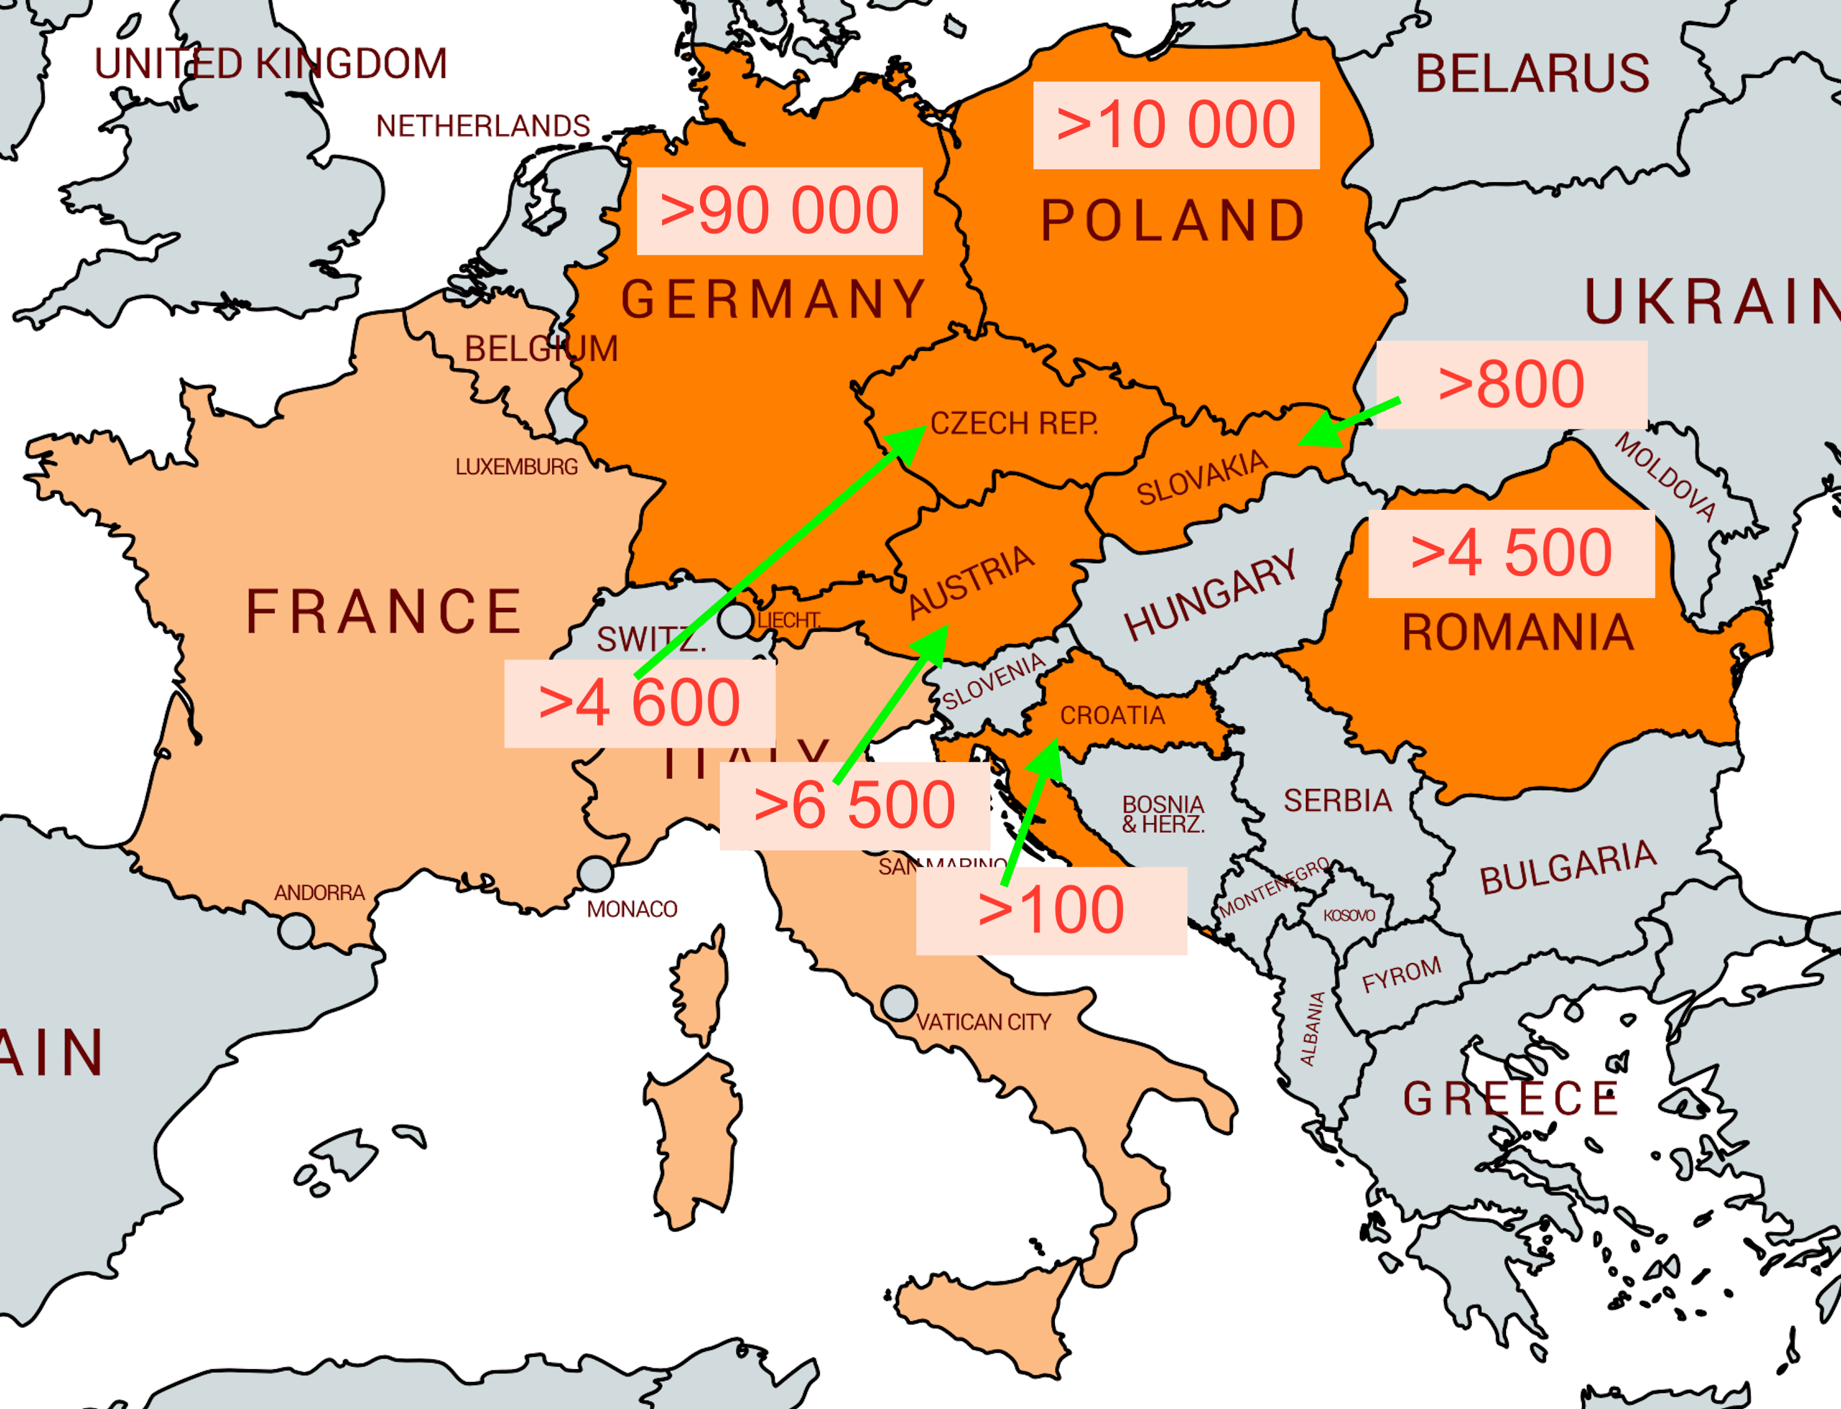
C. 2. Tax Adviser Organizations in Europe
05

Slide 7
C. 3. Tax Adviser Organizations in Europe
There are certain forms of regulation in Belgium, France and Italy
The tax advising profession is not regulated in other European countries, instead it is lead by self-governing organizations with voluntary membership
However, these organizations do require that the tax adviser meets certain conditions
Professional Regulation and the Acts on Tax Advisory of the Czech Republic, Slovakia and Poland were inspired by Germany
Compared to German regulation, the Czech professional rules are:
fewer
less restrictive
without fee regulation
without limitation of other business activities of tax advisers
without restrictions on advertisement
06

Slide 8
D. Experiences from the Work of Czech Tax Advisers 1. TAX ADVISORY REGULATORY FRAMEWORK in the CZECH REPUBLIC
Administrative Procedure Code
Statute
Criminal Code
Examination Rules
Act on Tax Advising of Tax Advisory (no. 523/92 Coll.)
Tax Procedure Code
Disciplinary Code
Anti-Money Laundering Act
Code of Ethics
Recognition of professional qualifications
Other internal rules and guidelines
Act on electronic government
SELF-REGULATIONS
LEGISLATIVE
07

Slide 9
D. Experiences from the Work of Czech Tax Advisers 2. I. EXAMPLES of LEGISLATIVE INTERLINKS
Act on Tax Advisory § 11/d,e (Self-Regulation)
The Chamber issues the Statutes, Election Rules and Disciplinary Code
The Chamber issues, upon an agreement with the Ministry the Examination Rules
Act on Tax Advisory § 6/9 (Lex Specialis)
Tax advisers are obliged to maintain confidentiality
They can only be released from this obligation by their client, even for the purpose of criminal proceedings
The fulfilment of obligations set by the Anti-Money Laundering Act is not considered a breach of confidentiality
08

Slide 10
D. Experiences from the Work of Czech Tax Advisers 2. II. EXAMPLES of LEGISLATIVE INTERLINKS
Tax Procedure Code (Section 136)
Tax Administrative Code sets a special regime for tax advisers. The taxpayers represented by tax advisers have 3 extra months to submit their tax returns
Anti-Money Laundering Act
The Chamber is competent authority for tax advisory in the field of AML Act
The Chamber guarantees compliance with the AML Act and supervises fulfillment of tax advisers' duties under the AML Act.
09

Slide 11
D. Experiences from the Work of Czech Tax Advisers 3. Basic Principles of Regulation I. Tax Advisory Is Defined by Law as Legal Advisory
“Provision of legal aid and financial and economic advice in the matters of
taxes, levies, fees and other payments (hereinafter referred to as ‘taxes’),
as well as in the matters that are directly connected with taxes (hereinafter
referred to as ‘tax consultancy’ or ‘tax advisory services’).” (Section 1)
According to Czech legislation, a tax adviser is an individual registered in the list of tax advisers administered by the Chamber.
The membership in the Chamber is compulsory.
The Chamber registers legal persons providing tax advisory services.
These have the same position in the tax proceedings as tax advisers. They are also obliged to comply with the same professional rules as tax advisers.
10

Slide 12
D. Experiences from the Work of Czech Tax Advisers 3. Basic Principles of Regulation II. Rights and Obligations of Tax Advisers
“Tax Advisers are authorised and obliged to protect the rights and
authorised interests of their clients. They are obliged to act honestly and
conscientiously, to consistently use all legal means and to apply all what
they consider beneficial according to their belief and according to the client’s
instructions. While doing so, they are bound only by the Acts and other
generally binding law regulations and within their limits by the client’s
instructions.” (Section 6/1).
Tax advisers must retain in confidentiality all information learned in connection with rendering tax advisory services.
Tax advisers are liable for damage incurred by the client in connection with the tax advisory services provided.
The basic obligations of tax advisers include the obligation to have a professional liability insurance.
11

Slide 13
E. 1. The Mission of Tax Advisers
CFE Opinion Statement PAC 2/2016 and FC 8/2016 from June 16th, 2016:
The tasks of tax advisers
Tax advisers are responsible for helping their clients comply with their obligations under tax law and to enable them to make full use of their rights in tax matters.
Taxpayers assisted by their tax advisers have to provide tax administration with the cooperation necessary to carry out a correct assessment of taxes.
Respecting the client’s interest
Tax advisers will ensure that their clients take informed decisions. If a client asks a tax adviser to engage in an arrangement which, albeit being legal, may have negative consequences for the client, as it maybe deemed aggressive by tax authorities or cause slander, the tax adviser will make the client aware of this risk.
The final decision shall rest with the client.
The key aspect of cooperation between tax advisers and clients is their relationship based on dependability and trust.
12

Slide 14
E. 2. The Mission of Tax Advisers
Trust between the client and the tax adviser is essential.
The scope of professional privilege of tax advisers is similar to the professional privilege of lawyers.
The privilege cannot be relied on to prevent tax authorities' access to taxpayers' information.
Tax advisers should stay on the side of clients and help them fulfill their legal obligations and support them when facing new challenges including technology innovations.
The final decision should make the client.
The profession should be active in communication with all relevant stakeholders.
The new OECD and EU initiatives are mainly about politics and political decisions.
The profession must defend the principles it stands on, yet at the same time it must be capable of adapting to the changing tax environment.
13

Slide 15
Jiri Nekovar
JNekovar@EuroTrend.cz

