Slide 1




Dangerous Aspects of Introducing GAAR
into our Domestic Legislation:
--A Case for Prewar Germany
September 13, Thursday
Ulaanbaatar, Mongolia, 2018

Slide 2
By Minoru NAKAZATO
中里 實
Professor of Law, the University of Tokyo
Chairman, Tax Commission of the Government of Japan
Ulaanbaatar, Mongolia, 2018

Slide 3
Сайхан улс оронд энэ олон улсын бага хуралд намайг урьсанд маш их баярлалаа. Өнөөдөр энд байхдаа би маш их баяртай байна.
Thank you very much for inviting me to this international conference in the beautiful country. Today I am very much honored to be here.
Ulaanbaatar, Mongolia, 2018

Slide 4
Dangerous Aspects of GAAR: Outline
Tax Administration loves GAAR. Still we have to take into account some dangerous aspects of introducing GAAR.
I. Introduction
II. Ancient Examples of Tax Shelters
III. GAAR in Prewar Germany
IV. Conclusion

Slide 5
I. Introduction on Tax Shelters
Tax Shelters are elegant and powerful.
In this respect, they are similar to Nike.
A. Νίκη της Σαμοθράκης
B. What is she doing?
C. Similarity: Winged Victory is just like
Tax Shelter schemes
D. Another Similarity between
Winged Victory and Tax Shelter
E. Conclusion

Slide 6
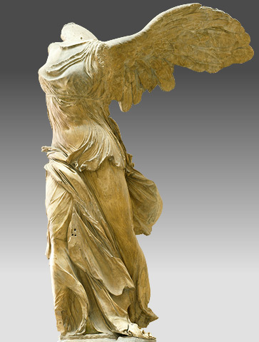
I.A. Νίκη της Σαμοθράκης
Let me start my presentation with a famous sculpture in Louvre Museum in Paris:
Nike, or Winged Victory of Samothrace
（Νίκη της Σαμοθράκης）

Slide 7
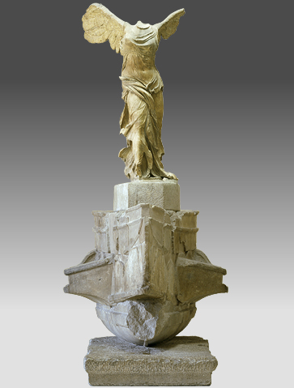
I.B. What is she doing?
⇒ Floating in the Air
Please look at the Winged Victory Carefully.
“The right foot was just alighting on the ship’s deck,
while the left was still in the air.
The Victory was not striding forward, but rather alighting on the ship, barely skimming the base.”

Slide 8
I.C. Similarity:
Winged Victory is just like Tax Shelter,
Because of her mysterious features:
she has no head,
she has wings, and
she is floating in the air.

Slide 9
I.D. Another Similarity between Winged Victory and Tax Shelter:
That is, Winged Victory always wins !!
Tax Avoiders always win at least in the long run.

Slide 10
I.E. Conclusion:
The skill and power of corporations for minimizing the tax burden is really amazing, especially in their behaviors of developing tax avoidance schemes.
Therefore, I have depicted a tax avoiding taxpayer as Nike, the Winged Victory of Samothrace.

Slide 11
II. Ancient Examples of Tax Shelters
Here, I explain two historically important examples of ancient tax shelters: one from Japan and one from China.
A. General Ideas of Tax Shelters
B. Japanese Poll Tax
C. Chinese Salt Tax

Slide 12
II. A. General Ideas of Tax Shelters
Wide-spread use of Tax Shelters are closely associated with the government change: Revolution.
Here is the logic:
Flourishing Tax Shelters
⇒ Revenue Loss of the Government
⇒ Provision of Public Goods declines
⇒ Rise of Private Governments
⇒ Revolution by a private government

Slide 13
II. B-1. Example 1: Japanese Poll Tax
Ramseyer and Nakazato, The Tax Incentives That Destroyed the Government: An Economic Analysis of Japanese Fiscal Policy, 645-1192, 51-3 Shakai Kagaku Kenkyu 3-12, 2000
Taika Revolution of 645 A.D.（大化改新）introduced the Poll Tax that imitated zuyongdiao (租庸調）system in Sui (隋）and Tang (唐）Dynasty.
In 1192 A.D. The head of Samurai, Minamoto Yoritomo (源頼朝) established Kamakura Shogunate (鎌倉幕府): de facto government led by the Samurai class, which is independent from Kyoto government.
What happened during those years? ⇒ widespread use of tax shelters

Slide 14
II. B-2. Japanese Poll Tax and Tax Shelter
Aristocrats were exempted from the poll tax（租庸調）in the system established in 645 A.D.
Samurai people donated their newly-cultivated farm lands to the Aristocrats who could own the farm lands as tax-free manors. In return, Samurai received managing fees.
⇒ This is an ancient case of a tax shelter.
It is similar to the modern Sale and Lease Back
Manors (荘園) were, in fact, controlled by the Samurai people and they didn’t pay much rents to the Aristocrats.
Samurai took power, while Kyoto declined.
⇒ Establishment of Kamakura Shogunate in 1192 A.D.

Slide 15
II. C-1. Example 2: Chinese Salt Tax
Nakazato, Rent seeking and History of ancient tax shelters in Japan and China: the case for Japanese poll tax and Chinese salt tax, 6 University of Tokyo Law Review, 2011

Slide 16
II. C-2. Chinese Salt Tax and Optimal Tax Theory
A. Optimal tax theory suggests that a tax on necessities (like salt) can be economically efficient. Because the elasticity of demand for such goods is low, the tax does not affect behavior.
People need salt, and need it in largely fixed quantities. As a result, they can no more avoid the salt tax by changing the way they behave.
Because this type of tax does not distort market decisions, it raises revenue efficiently.

Slide 17
II. C-3. Chinese Salt Tax and the History
If fact, of course, the Chinese salt tax was not efficient. Chinese consumers may not have much changed the amount of salt they consumed, but they did change the way they acquired it.
Because they aggressively tried to avoid the tax, the salt tax led to the development of a large black market.
That market created a corps of illegal salt dealers（鹽賊, 塩密売人）. Those dealers overturned the government.

Slide 18
II. C-4. Chinese Salt Tax and the Decline of Tang Dynasty
During the era of the Emperor Xizong (僖宗) of Tang Dynasty, in 879, the rich salt smuggler Huan Chao (黄巣), combined with other salt traders Wang Xianzhi (王仙芝) and Shang Rang (尚讓), began a revolt.
The power of Tang Dynasty declined dramatically after this revolt. Local military commissioners took over the control of various regions.
Even though Huan Chao himself was killed in 884, the powerful Tang Dynasty itself was ultimately destroyed in 907 by his followers.

Slide 19
III. GAAR in Prewar Germany:
Now is the time for our main topic.
Please note that I first began my academic career in the study of Handelsbilanz and Steuerbilanz (Financial accounting and Tax accounting) in Germany.
A. General Idea
B. GAAR in History

Slide 20
III. A. General Idea
I would like to show you that General Anti-Avoidance Rule could be very dangerous, which could be illustrated in the case of prewar Germany: Nazi period.
Markus Seiler, GAARs and Judicial Anti-Avoidance in Germany, the UK and the EU (Schriftenreihe zum Internationalen Steuerrecht, Band 98), pp. 12-13, 2016

Slide 21
III. B. GAAR in History
I will explain you a brief history of the introduction of GAAR in the prewar Germany.
1. Reichsabgabenordnung（RAO）
2. Wirtschaftliche Betrachtungsweise
3. GAAR in RAO
4. Steueranpassungsgesetz of 1934
under Nazi Germany
5. Court Decisions on GAAR in the era

Slide 22
III.B.1. Reichsabgabenordnung（RAO）
After the World War I, in order to raise revenue for reconstruction, Reichsabgabenordnung (Federal Tax Act) was enacted on December 13, 1919.
In the Act, die wirtschaftliche Betrachtungsweise (Observation based on economic substance: substance over form doctrine) was adopted.
Professor Enno Becker led the movement.

Slide 23
III.B.2. Wirtschaftliche Betrachtungsweise
Article 4 of the Reichsabgabenordnung stipulated die wirtschaftliche Betrachtungsweise.
“Bei Auslegung der Steuergesetze sind ihr Zweck, ihre wirtschaftliche Bedeutung und die Entwicklung der Verhältnisse zu berücksichtigen.”
Translated: “When interpreting tax statutes, their purpose, their economic meaning and the evolution of conditions must be taken into account.”

Slide 24
III. B.3. GAAR in RAO
Article 5 of the Reichsabgabenordnung was a typical GAAR, which is based on die wirtschaftliche Betrachtungsweise (substance over form doctrine).
Its paragraph 1 says:
”Durch Missbrauch von Formen und Gestaltungsmöglichkeiten des bürgerlichen Rechtes kann die Steuerpflicht nicht umgangen oder gemindert werden.”
translated: "Through abuse of forms and design possibilities in civil law, the tax liability can not be circumvented or reduced."

Slide 25
III.B.4. Steueranpassungsgesetz of 1934 under Nazi Germany
After Nazi took power in 1933, Steueranpassungsgesetz was enacted on October 16, 1934. Its Article 1 says,
(1) Die Steuergesetze sind nach nationalsozialistischer Wertanschauung auszulegen.
(2) Dabei sind die Volksanschauung, der Zweck und die wirtschaftliche Bedeutung der Steuergesetze und die Entwicklung der Verhältnisse zu berücksichtigen.
(3) Entsprechende gilt für die Beurteilung von Tatbeständen.
(1) The tax statutes are to be interpreted according to the ideology of the National Socialist.
(2) Account must be taken of the beliefs of the people, the purpose and economic importance of tax statutes and the evolution of conditions.
(3) The same applies to the finding of facts.

Slide 26
III.B.5. Court Decisions on GAAR
Article 1, paragraph 1 of the Steueranpassungsgesetz of 1934 is the ultimate basis of arbitrary interpretation of tax statutes in favor of the tax authorities, in the Nazi period.
It produced aggressive decisions of the Reichsfinanzhof (Supreme Federal Tax Court), such as that allowed the application of GAAR just because the transaction had given small tax benefits to the taxpayer.

Slide 27
IV. Conclusions: GAAR could be dangerous.
Here is my coclusion, which I have found in:
Sima Qian司馬遷：Shiji (史記-Historian’s Records),
Huozhi liezhuan (貨殖列傳-Biographies of Merchants)
“ 故善者因之，其次利道之，其次教誨之，
其次整齊之，最下者與之爭”
Gù shàn zhě yīn zhī, qícì lì dào zhī, qícì jiàohuì zhī, qícì zhěngqí zhī, zuì xià zhě yǔ zhī zhēng

Slide 28
IV. Conclusions in English
Here is its English translation.
Therefore the best way is to take into account natural inclinations of the people.
The next best is to guide the people with benefits.
The next is to teach the people morals.
Then the next is to organize them.
And the worst is to compete with them.

Slide 29

From Minoru ( 實, Shih )
NAKAZATO ( 中里, Zhong-Li )
Thank you!

