Slide 1




THE GAAR: A SWORD OR SHIELD
FOR TAX AUTHORITIES?
Professor Rick Krever
Australia
Ulaanbaatar, Mongolia, 2018

Slide 2

GAARS
a short history
what’s in a GAAR?
what are GAARs for?
pluses and minuses
problem points: what is litigated?
international tax and GAARs
the Mongolian GAAR
conclusion
01

Slide 3
GAARs: A short history
first adopted in New Zealand in 1879 in a property tax law
became an income tax law in 1891
1913-1918 spread of income tax to most western countries
some adopted GAARs initially
judicial doctrines substituted in some countries: “substance over form” (US); step transaction (UK)
1980-2018 many more GAARs adopted including US and UK
GFC, OECD recommendation and BEPS led to further adoptions
02

Slide 4
GAARS
a short history
what’s in a GAAR?
what are GAARs for?
pluses and minuses
problem points: what is litigated?
international tax and GAARs
the Mongolian GAAR
03

Slide 5
WHAT’S IN A GAAR?
widest range of variations imaginable
the starting point for most post-1980 GAARs was the Australian 1981 GAAR
Australia had had a GAAR for half a century by that point and drafted a new one to overcome all the problems that had been observed
while the format and language is different, most GAARs share some common features
04

Slide 6
WHAT’S IN A GAAR?
scheme
tax minimisation purpose
small number look for effect
definition of tax minimisation
  reduce income
  increase deductions
  increase credits
  change timing
does not apply to concessions
reconstruction rule
05

Slide 7
WHAT’S IN A GAAR?
have to find some sort of scheme, arrangement, transaction
traditionally, have to have a tax minimisation motive (the main purpose, the primary purpose, mostly for …)
very small number look for the main effect
definition of tax minimisation (tax avoidance)
  reduce income
  increase deductions
  increase credits
  change timing of deductions or inclusions
06

Slide 8
WHAT’S IN A GAAR?
exception for tax minimisation endorsed by the legislation (deliberate concessions)
reconstruction rule (strike down the arrangement and substitute another one)
  reconstruction rule extends to 3rd parties (example – deny taxpayer a deduction for payment to a 3rd party then remove payment from 3rd party’s income)
07

Slide 9
GAARS
a short history
what’s in a GAAR?
what are GAARs for?
pluses and minuses
problem points: what is litigated?
international tax and GAARs
the Mongolian GAAR
08

Slide 10

SHIELD OR SWORD?
09

Slide 11
SHIELD OR SWORD?
are GAARs to be used to protect the base against unexpected schemes (shield)?
or
are GAARs to fix the base where the legislation has a gap or problem (sword)?
10

Slide 12

CANADA TRUSTCO
11

Slide 13
CANADA TRUSTCO
Transamerica Leasing Inc. wanted to borrow from Canada Trustco Mortgage Company
offered to provide a mortgage over its trailers
Transamerica did not have enough profits to use the concessional accelerated deprecation allowed in Canada
12

Slide 14
CANADA TRUSTCO
restructured the secured loan as a ‘sale and leaseback’ – TLI sold trailers to Canada Trustco and leased back on a finance lease
for accounting purposes was treated as a loan from CT to TLI and TLI treated as the owners
for tax purposes, tax office had always accepted the “form” of a sale and leaseback as an operating lease, with the bank allowed the accelerated depreciation and the borrower deducting the full cost.
13

Slide 15
CANADA TRUSTCO
for tax purposes, tax office had always accepted the “form” of a sale and leaseback as an operating lease, with the bank allowed the accelerated depreciation and the borrower deducting the full cost.
BUT NOT for such a large scheme with the entire fleet of truck trailers sold and leased back
Supreme Court refused to allow the tax office to use the GAAR
14

Slide 16

UNIT TREND
15

Slide 17
UNIT TREND
construction business had a group of companies
joined two concessions together in an unintended and unexpected way
used a special rule for intra-group sales to transfer apartments from one company to another for a high price with no VAT
used another special rule for simplified calculation of VAT on the sale of new housing
combination allowed the group to recover all input tax and have almost no output tax on sales to apartment buyers
High Court struck down the arrangements on the basis of the GAAR
16

Slide 18
SHIELD OR SWORD
tax office is successful when using GAAR as a shield (avoidance through unexpected scheme that legislation could not have foreseen)
tax office is not successful when using GAAR as a sword (filling a gap in the law
when GAAR is used as a sword, courts strike down the tax office’s assessment and tell the government if it wants to fix the problem, fix the law
17

Slide 19
UNIT TREND
18

Slide 20
CANADA TRUSTCO
19

Slide 21
GAARS
a short history
what’s in a GAAR?
what are GAARs for?
pluses and minuses
problem points: what is litigated?
international tax and GAARs
the Mongolian GAAR
20

Slide 22
PLUSES AND MINUSES
Case for GAARs
legislature cannot anticipate every possibility
but the policy intent should be clear and should be protected
Case against GAARs
ineffective (only apply to the facts of one case)
unfair (only a fraction of persons are caught by it)
contrary to rule of law principle: legislature makes the tax law, not the person responsible for collecting the tax
discourages investors (investors are uncertain of tax liability)
compromise: review panel
21

Slide 23
SHIELD OR SWORD
Why unfair?
only some of the taxpayers using the scheme are audited
auditors uncover the scheme in a small number of those
auditors decide to challenge in a smaller number
most are settled; a smaller number are litigated on the basis of the GAAR
if the revenue wins, holding is limited to the facts of the case
22

Slide 24
GAARS
a short history
what’s in a GAAR?
what are GAARs for?
pluses and minuses
problem points: what is litigated?
international tax and GAARs
the Mongolian GAAR
23

Slide 25
WHAT’S IN A GAAR?
scheme
tax minimisation purpose
small number look for effect
definition of tax minimisation
  reduce income
  increase deductions
  increase credits
  change timing
does not apply to concessions
reconstruction rule
24

Slide 26
PROBLEM POINTS: WHAT IS LITIGATED?
what is the scheme
some cases, it is the single event
example: convertible debt
25

Slide 27
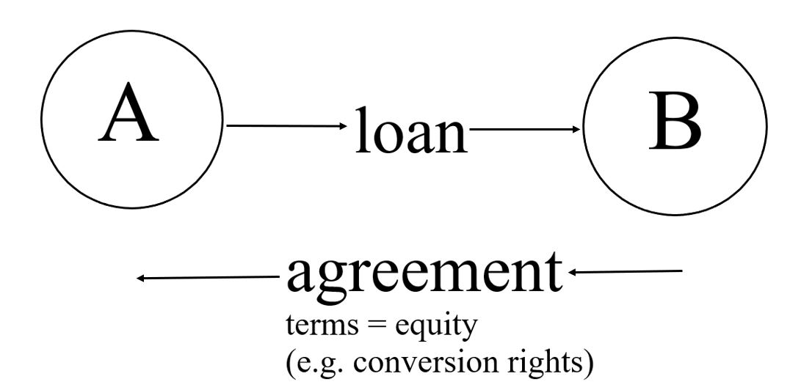
CONVERTIBLE DEBT
26

Slide 28
REPO TRANSACTION
what is the scheme
some cases, it is linked transactions: repo transaction
27

Slide 29
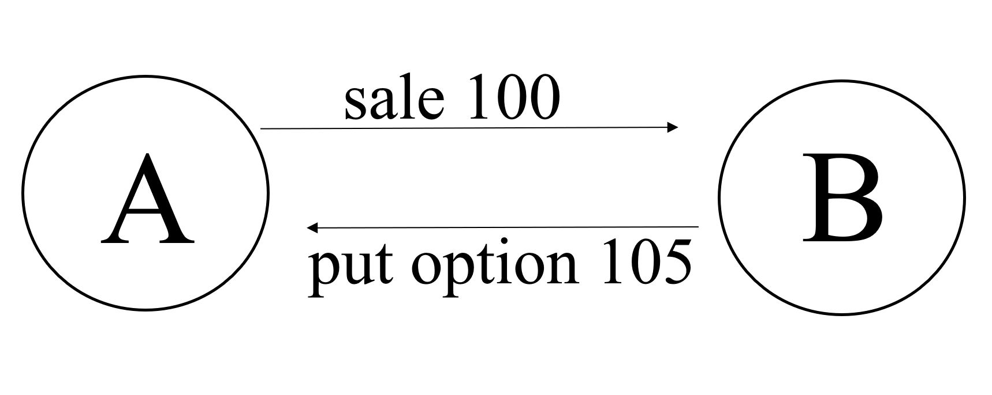
REPO TRANSACTION
28

Slide 30
REPO TRANSACTION
original sale for 100 and guaranteed repurchase for 105 after a fixed period both signed at the same time
it’s clear once both elements are carried out all we have is a secured loan
US courts simply collapse the two and say it’s all one transaction and therefore is a loan, not two sales
UK courts did not apply the step transaction doctrine to collapse and legislation was used to fix the problem
this could be caught by a GAAR with the scheme the one economic transaction divided into two legal transactions
29

Slide 31
COMBINATION OF INNOCENT TRANSACTIONS
what is the scheme
some cases, it is a combination of innocent transactions there were never intended to be used together
30

Slide 32
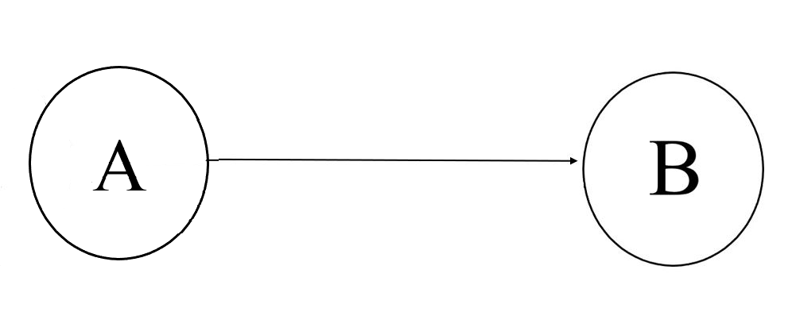
COMBINATION OF INNOCENT TRANSACTIONS
31

Slide 33
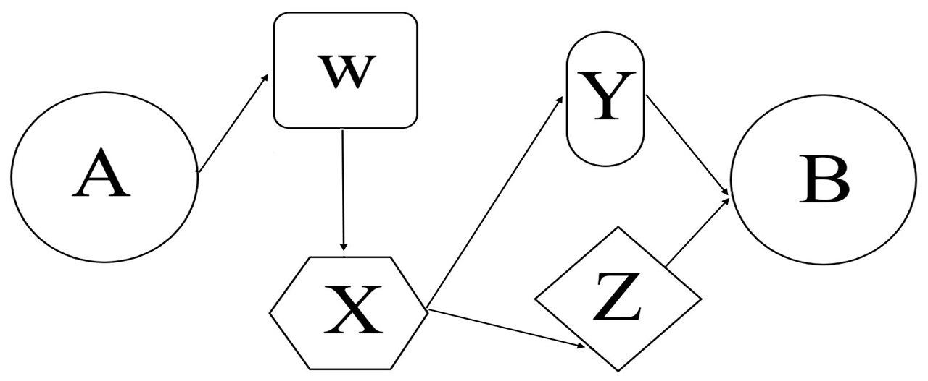
COMBINATION OF INNOCENT TRANSACTIONS
32

Slide 34
COMBINATION OF INNOCENT TRANSACTIONS
each element involves a deliberate concession – an incorporation rollover, an exemption for intra-group dividends, a rollover on winding up, etc.
33

Slide 35
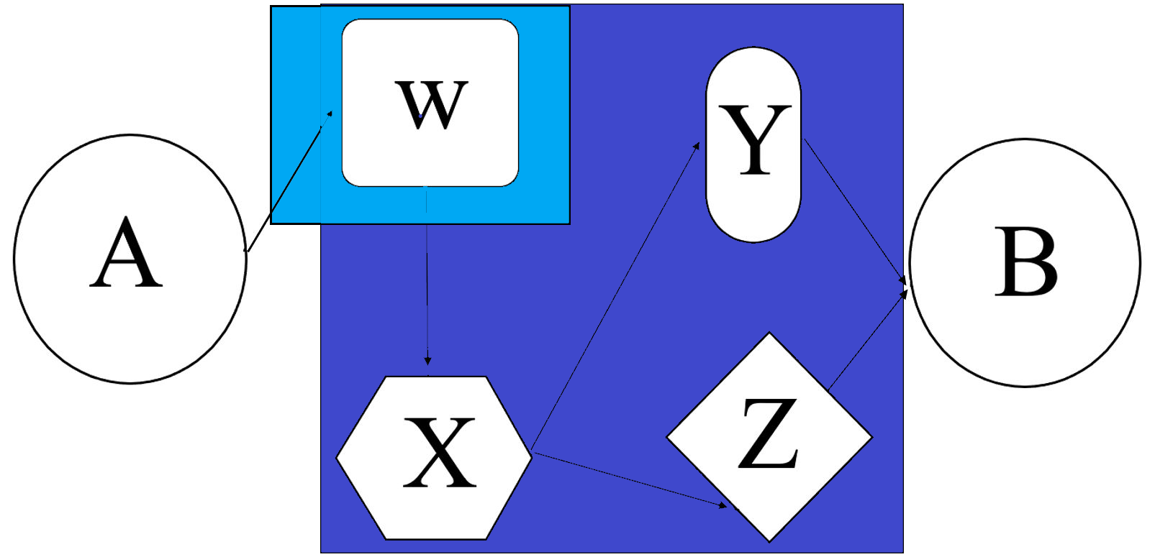
COMBINATION OF INNOCENT TRANSACTIONS
34

Slide 36
COMBINATION OF INNOCENT TRANSACTIONS
there is no avoidance for each transaction with a deliberate concession
35

Slide 37
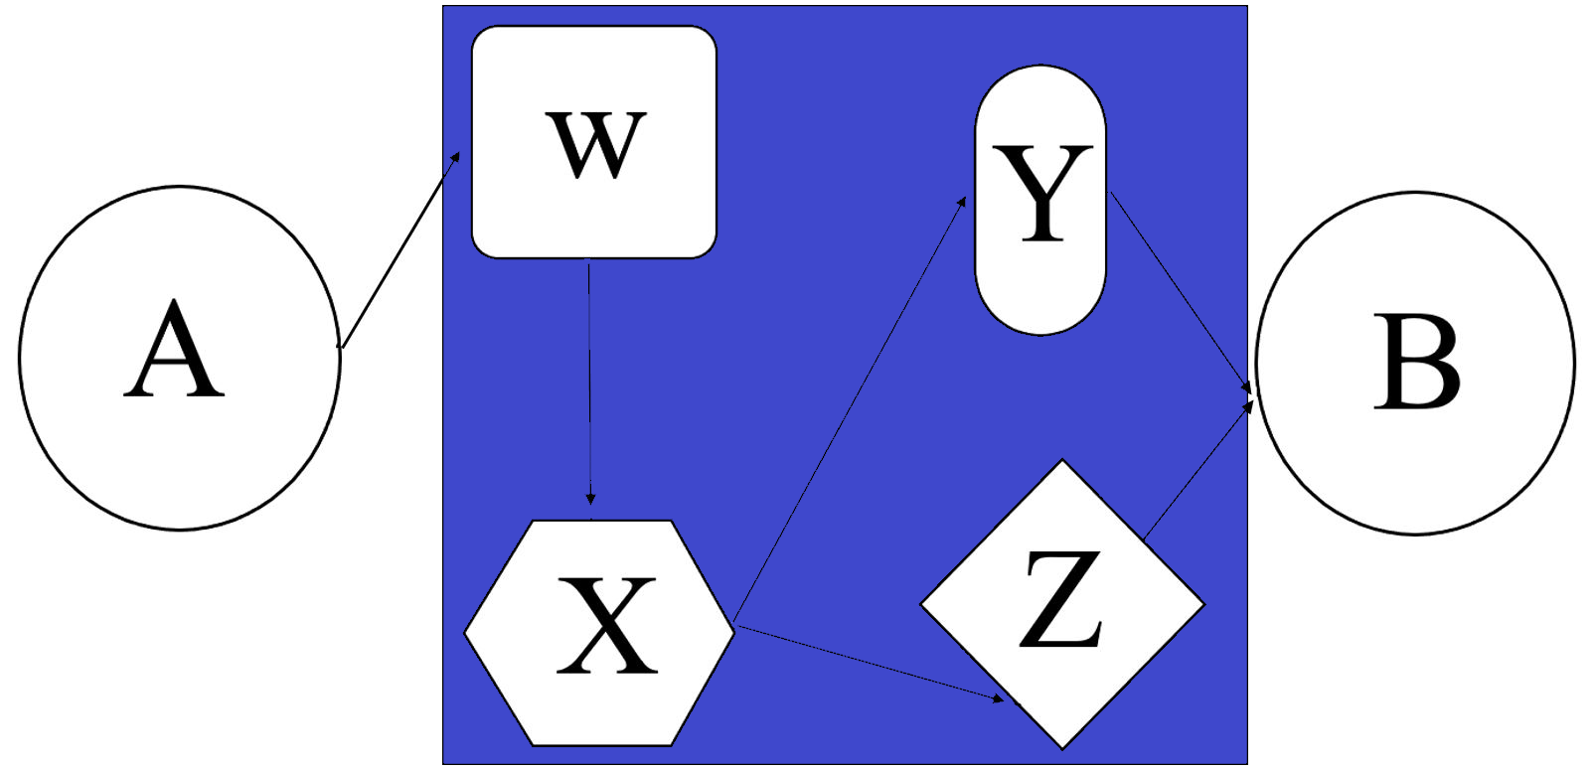
COMBINATION OF INNOCENT TRANSACTIONS
36

Slide 38
COMBINATION OF INNOCENT TRANSACTIONS
37

Slide 39
PROBLEM POINTS: WHAT IS LITIGATED?
but the legislature never conceived someone would join many of them together into a scheme that allows the transfer from A to B to escape tax completely while the direct sale would have attracted tax
38

Slide 40
PROBLEM POINTS: WHAT IS LITIGATED?
what is the main purpose
the main purpose depends on what part of the scheme is considered
39

Slide 41
WHAT IS THE PURPOSE OF THE SCHEME?
40

Slide 42
WHAT IS THE PURPOSE OF THE SCHEME?
The main purpose of the sale from A to B is to transfer ownership from A to B
41

Slide 43
WHAT IS THE PURPOSE OF THE SCHEME?
42

Slide 44
WHAT IS THE PURPOSE OF THE SCHEME?
the main purpose of the totality of arrangements is to transfer ownership from A to B
but the main purpose of the scheme is to avoid tax on the transfer from A to B
43

Slide 45
GAARS
a short history
what’s in a GAAR?
what are GAARs for?
pluses and minuses
problem points: what is litigated?
international tax and GAARs
the Mongolian GAAR
44

Slide 46

INTERNATIONAL TAX AVOIDANCE
45

Slide 47
INTERNATIONAL TAX AVOIDANCE
domestic law has many specific anti-avoidance rules
  dividend stripping (recharacterise capital gains as dividends)
  thin capitalisation (treat interest as dividend)
  CFC (look through controlled foreign company)
domestic law may also have a GAAR that recharacterises transactions
how are conflicts between treaties and domestic anti-avoidance rules resolved?
46

Slide 48
GAAR vs. TREATY
can source country use GAAR to override the treaty?
great international tax debate about this question
not tested yet. Countries have used the GAAR to override the treaty and impose tax on the non-resident. But they’ve found ways to collect it from a resident who cannot claim treaty protection.
47

Slide 49
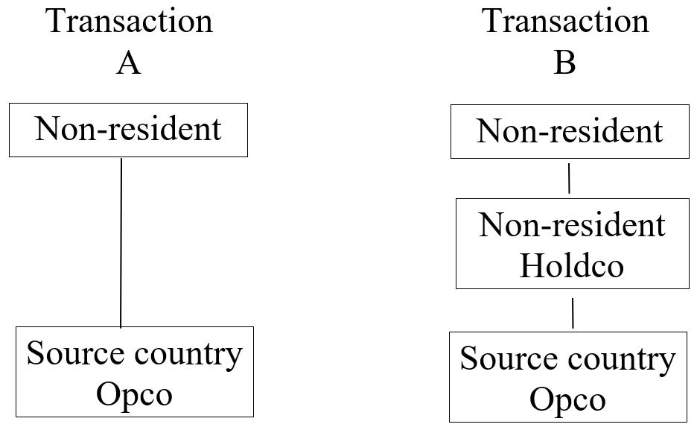
GAAR vs. TREATY
48

Slide 50
GAAR vs. TREATY
treaty says source country can tax non-resident in transaction A
treaty says only non-resident’s home country can tax non-resident in transaction B
source country tax authority says, under source country GAAR, we say but for your tax avoidance scheme, you would have owned shares directly and sold shares in Opco, not Holdco
can source country use GAAR to override the treaty?
49

Slide 51
GAARS
a short history
what’s in a GAAR?
what are GAARs for?
pluses and minuses
problem points: what is litigated?
international tax and GAARs
the Mongolian GAAR
50

Slide 52
MONGOLIAN GAAR
15.1. Tax Authority shall take measures against tax avoidance in following circumstances:
(a) taxpayer alone or together with other persons entered into or carried out a scheme;
(b) a tax benefit has been obtained under the scheme;
15.2. [recalculate as if there had not been a scheme]
[compensating changes to third parties in the scheme]
51

Slide 53
MONGOLIAN GAAR
(a) taxpayer alone or together with other persons entered into or carried out a scheme;
(b) a tax benefit has been obtained under the scheme;
key difference from other GAARs:
“tax benefit” drafted for income tax and probably will not apply to VAT
no exception for permissible concessions
no “purpose” requirement – but is it implicit?
52

Slide 54
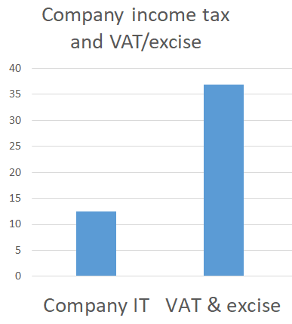
MONGOLIAN GAAR
53

Slide 55
MONGOLIAN GAAR
PIT rate would be 10%
CIT rate would be 25%
taxpayer choses to operate as an unincorporated business
GAAR
(a) taxpayer alone or together with other persons entered into or carried out a scheme;
(b) a tax benefit has been obtained under the scheme;
54

Slide 56
GAARS
a short history
what’s in a GAAR?
what are GAARs for?
pluses and minuses
problem points: what is litigated?
international tax and GAARs
the Mongolian GAAR
Conclusion
55

Slide 57
CONCLUSION
GAARs have relatively little impact on avoidance levels.
(only catch one taxpayer, etc.)
But are very useful as signalling devices of what has to be fixed in the law.
If tax authority tries to use as a sword, likely to lose on appeal (in most countries); if authority tries to use as a shield, likely to win on appeal.
If tax authority uses to override treaty, will seriously worry foreign investors.
56

