Slide 1
TAXPAYER CHARTER PROJECT
Presented By:
David Russell QC
Asia Oceania Tax Consultants’ Associatio,
Hanoi, 18 October 2013

Slide 2
Taxpayer Charter Project
Origins of the Project
Collaboration of Organizations
Study Methodology
Model Charter
Preliminary Report
What Comes Next
End Goals

Slide 3
Origins of the Project
Increased compliance burden
Increased complexity of legislation
Increased uncertainty in tax matters
Taxpayer Responsibilities:

Slide 4
Taxpayer Rights
Increasingly restricted
Little progress
No agreed on standard across world
No unified voice

Slide 5
Collaboration of Organizations
CFE – Europe AOTCA – Asia Pacific STEP – Worldwide
500,000 tax advisors
50 countries
73% of world GDP

Slide 6
WORLDWIDE COVERAGE
STEP | 15,000
CFE | 180,000
AOTCA | 330,000
Total Membership: over 500,000 worldwide (combined)

Slide 7
OVERLAP OF INTERESTS
CFE
AOTCA
STEP
STEP overlaps with AOTCA/CFE in private client areas which is major part of AOTCA/CFE agenda and a top priority.

Slide 8
Committee of 9 people CFE/AOTCA/STEP
Authors – 3 persons CFE/AOTCA/STEP
CFE – Ian Hayes AOTCA – David Russell STEP – Michael Cadesky
Website
Support staff – research – editorial

Slide 9
Study Methodology
Library of Research Materials
Compiled Extensive Survey
37 Countries Responded
164 Questions
Over 6,000 Answers

Slide 10
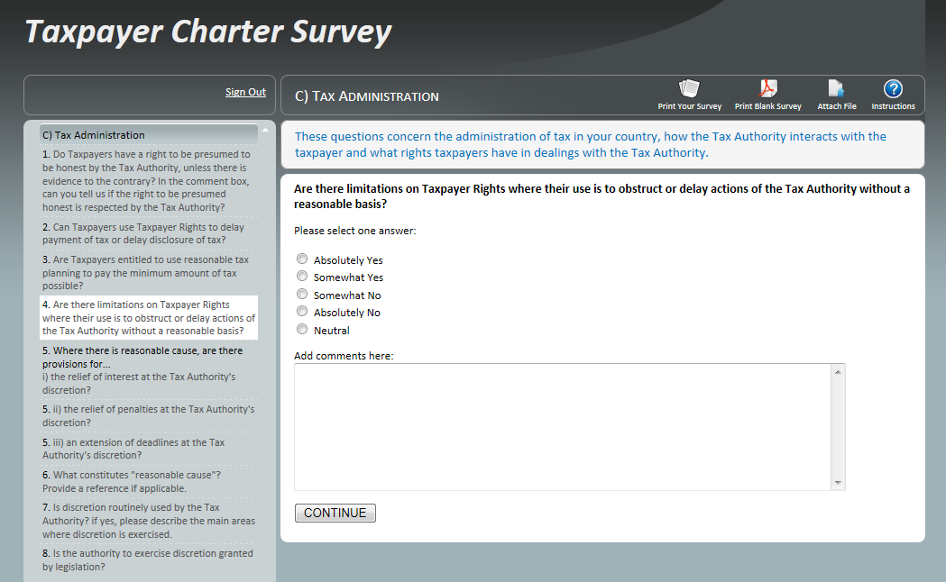
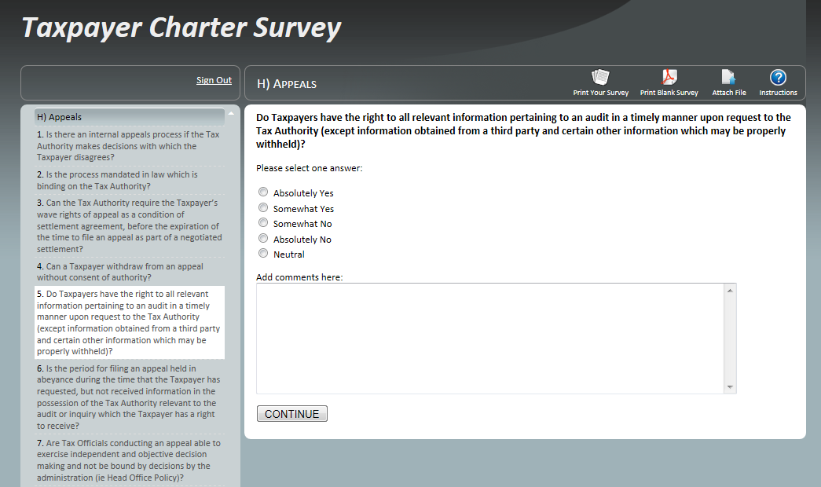

Slide 11
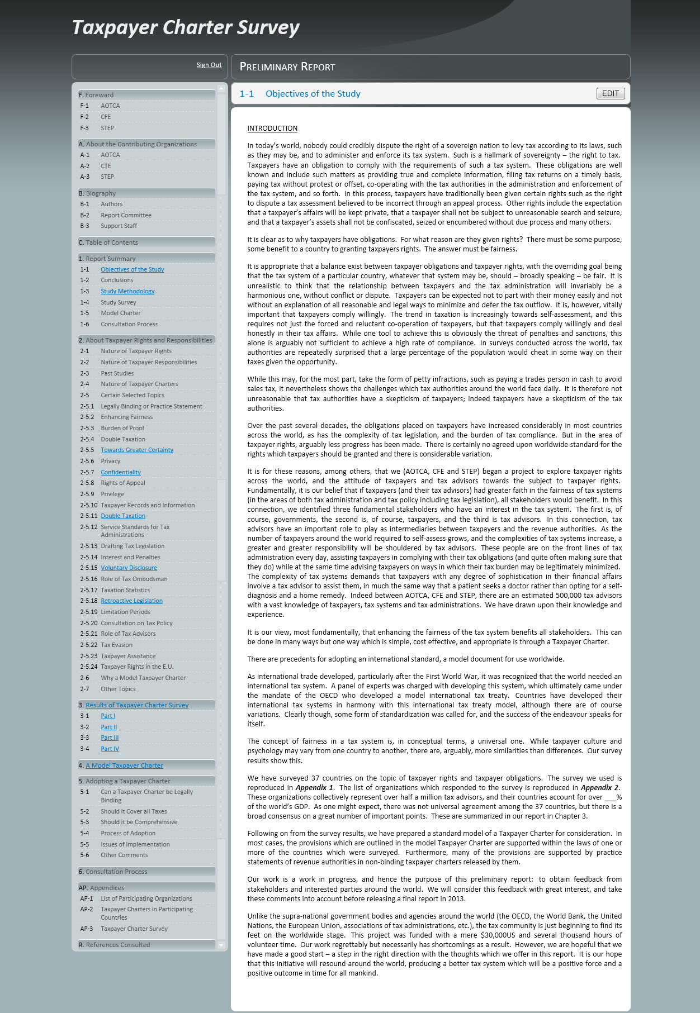

Slide 12
Model Charter Developed
Refined by Survey Results
Test of Validity (Charter ⬅➔ Survey)

Slide 13
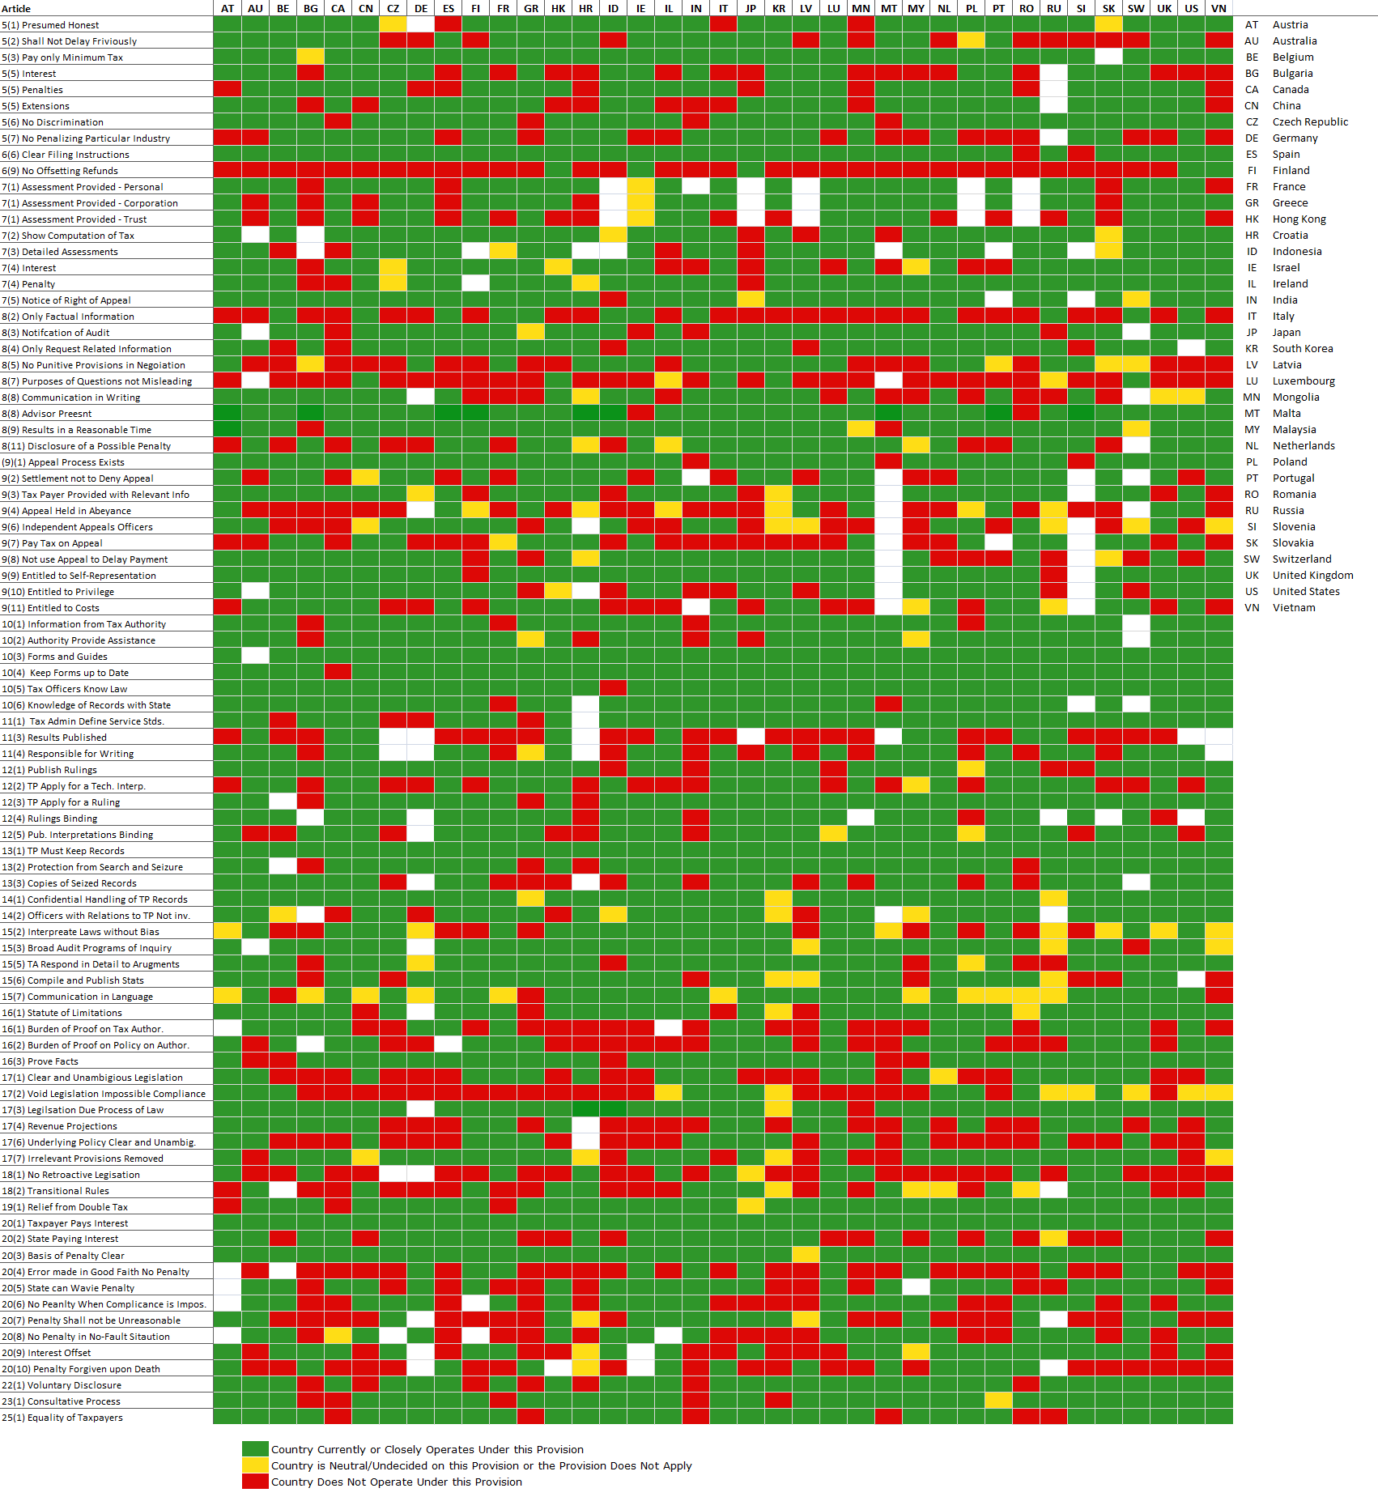

Slide 14
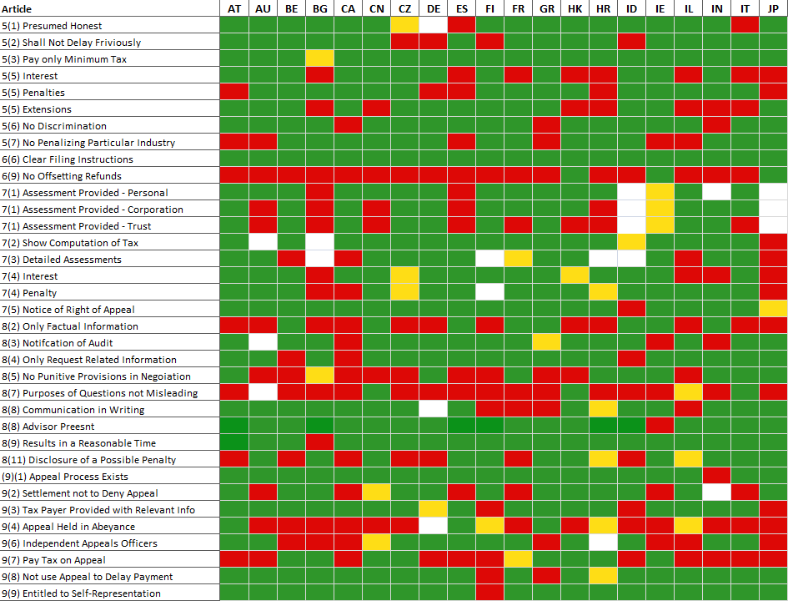

Slide 15
Model Charter
General Provisions
Tax Filings
Assessment
Audit
Internal Review and Appeal
Taxpayer Assistance
Service Standards
Rulings and Interpretations
Taxpayer Records

Slide 16
Model Charter
Confidentiality
Tax Administration Generally
Burden of Proof
Drafting Standards for Tax Legislation
Retroactivity of Legislation
Double Taxation and Relief
Interest and Penalties
Voluntary Disclosure
Legislative Process and Consultation

Slide 17
Model Charter
Tax Levied Only by Virtue of Law
Equality of Taxpayers
Matters Concerning Tax Advisors
Breach of Charter Rights
Enforcement and Collection
Tax Avoidance
Tax Evasion and Dishonesty

Slide 18
Preliminary Report
Length – 200 pages
Form – soft cover book
Distribution – Finance and Revenue Ministers, Commissioners, Deputies in 37 countries – OECD – E.U. Parliament – United Nations – IMF – World Bank – AOTCA/CFE/STEP – Media

Slide 19
Contents
Summary
Model Charter
Survey Results and Comments
Discussion of Selected Topics
Adoption of Taxpayer Charter
Consultation Process
Appendices

Slide 20
Selected Topics
Nature of Taxpayer Rights
Nature of Taxpayer Responsibilities
Past Studies
Nature of Taxpayer Charters
Onus of Proof
Double Taxation
Towards Greater Certainty
Privacy and Confidentiality
Rights of Appeal

Slide 21
Selected Topics
Collections
Privilege
Taxpayer Records and Information
Service Standards
Drafting Tax Legislation
Interest and Penalties
Voluntary Disclosure
Role of Tax Ombudsman
Taxation Statistics

Slide 22
Selected Topics
Retroactive Legislation
Limitation Periods
Consultation on Tax Policy
Role of Tax Advisors
Tax Evasion
Taxpayer Assistance
Taxpayer Rights within the European Union

Slide 23
What Comes Next
Preliminary Report is a Discussion Paper only
Input from Interested Parties
Government Tax Advisors (AOTCA/CFE/STEP bodies)
Consider All Input
Seminar
Reconsiderations and Edits
Final Report

Slide 24
End Goals
Worldwide Standard of Taxpayer Rights and Responsibilities
Adoption into Law by Countries
Foundation of a Good Tax System

Slide 25
The Longer Term
Possible Beginning of Future Collaboration
Give Tax Profession a Worldwide Voice

Slide 26
Progress to Date
January 2013 - Informal discussions with EU
May 2013 – Publication of Preliminary Report
Provision of same to professional bodies, Revenue Officials and other interested persons, including UN Committee of Experts on International Cooperation in Tax Matters

Slide 27
Progress to date (continued)
10 September 2013 – Meeting with OECD (Pascal St Amans, Director of the Centre for Tax Policy and Administration and others)
Recognition of need for balance as Exchange of Information and BEPS projects proceed
Clarity and professional consensus sought on evasion/avoidance issues

Slide 28
Progress to date (continued)
Further meeting scheduled for early next year.
Involvement of West African Association of Tax Institutes (www.wauti.org)
St Petersburg Declaration (CFE, WAATI and AOTCA Presidents)

Slide 29
Next steps
Seminar London First Half of 2014
Consideration of responses to draft Report
Completion of final Report based on responses received.

Slide 30
Outcomes to date
Taxpayer rights and role of tax professionals elevated to key issues in ongoing international tax reform agenda
Need for ongoing co-operation between professional bodies reinforced if profession’s voice is to be heard

Slide 31
Thank you for
your attention

