Slide 1
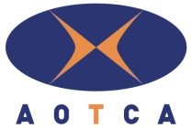
AOTCA Osaka Meeting 2015 and International Tax Conference
Social Contribution Activities Promoted by CPTAs Taxpayer Education
16 October 2015
Japan Federation of Certified Public Tax Accountants’ Associations (JFCPTAA)

Slide 2
ZEIRISHI, Certified Public Tax Accountant
Japanese Certified Public Tax Accountant
The Zeirishi badge
represents the sun
and a double-flowered
cherry blossom.
ZEIRISHI
The Certified Public Tax Accountant Act : The Zeirishi Act
The Japan Federation of Certified Public Tax Accountants Associations : the Japan Federation or JFCPTAA

Slide 3
Presentation topics
1
Key Terms of Taxpayer Education
2
Why is Taxpayer Education necessary?
3
Beginning of Taxpayer Education in Japan
4
Objectives of Taxpayer Education
5
Other Activities besides Tax Classes
6
Future Perspectives

Slide 4
1 Key terms Zeirishi want to convey
Obligation to pay tax
“The people shall be liable to taxation as provided by the law.” - Article 30, Constitution of Japan
Principle of taxation under the law
“No new taxes shall be imposed or existing ones modified except by law or under such conditions as the law may prescribe.” - Article 84, Constitution of Japan
Significance of the self-assessment system
The system of paying tax in which taxpayers calculate their own tax due based on the principle of sovereignty of the people and fulfill their obligation by paying taxes on their own initiative

Slide 5
2 Why is Taxpayer Education necessary?
1. Very few opportunities of Taxpayer Education at school
Very few explanations appear on school textbooks. Students have few opportunities to learn about taxes.
2. Self-assessment system vs the year-end adjustment system
Due to contrary two systems, many people have no chance to file their tax return.
Good judgement and awareness as taxpayers necessary

Slide 6
3 Beginning of Taxpayer Education in Japan
In 1950, the National Tax Agency (NTA) prepared auxiliary teaching materials for high school students.
Since then, tax officials have been dispatched mainly to elementary and junior high schools to teach students about taxes.
Since about 1995, zeirishi have begun to teach students about taxes at elementary, junior and senior high schools.
In 2003, the JFCPTAA designated the Taxpayer Education Program as a key measure.
In 2014, an amendment to the Zeirishi Act designated taxpayer education as an activity to be performed by Regional Associations.

Slide 7
4 Objectives of Taxpayer Education
The objectives of taxpayer education are to:
Help listeners understand tax systems, including the significance, functions and structure of taxes
Help listeners understand the principles of the self-assessment system and their rights and obligations as taxpayers
Foster good judgment and awareness among Japanese people in their role as taxpayers
Ensure that listeners fully understand the zeirishi system
(JFCPTAA’s Basic Policy on Taxpayer Education, set on 21 April 2011)

Slide 8
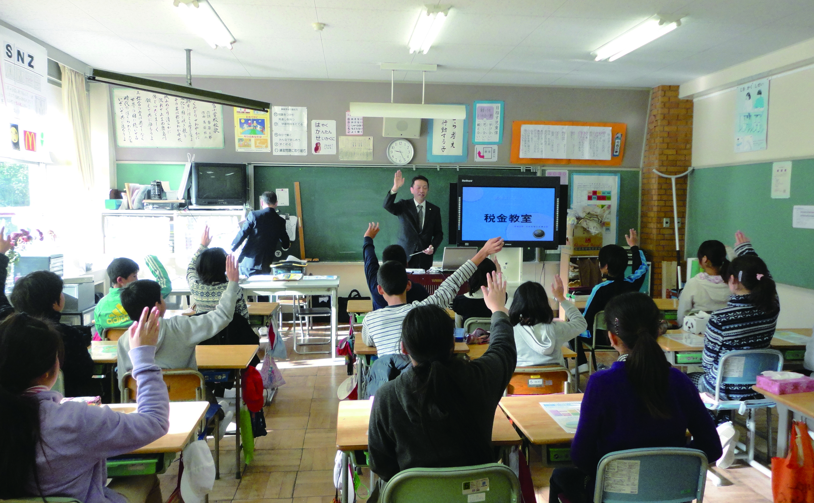
Tax Classes -1-
Tax Class

Slide 9
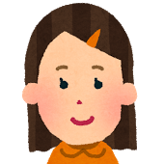
Tax Classes -2-
I learned about taxes for the first time and understand well how important taxes are.
I am surprised to know many taxes are used for many things in our school. I think we must handle them more carefully.
I often hear about wasting tax money on TV. I want to see more tax news on TV and in newspapers.
I thought Zeirishi were tax officials.

Slide 10
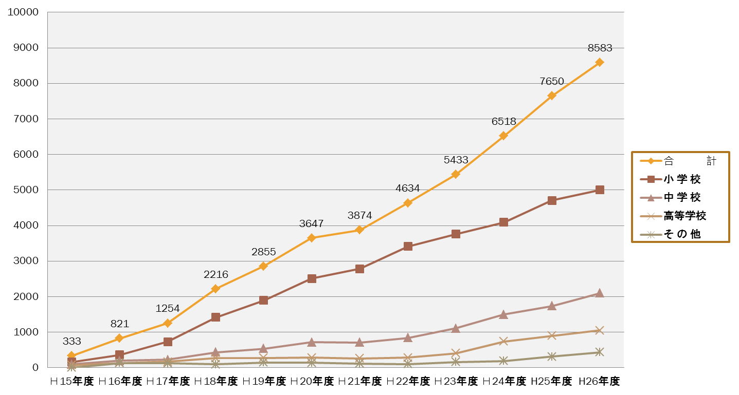
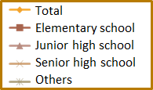
Tax Classes -3-
Rise in Number of Tax Classes Performed by Zeirishi

Slide 11
Tax Classes -4-
Tax Classes Held at Schools in Japan
Source : National Tax Agency (tentative data)
*1: Zeirishi and other persons related to the JFCPTAA
*2: The number of schools is based on the 2014 school basic survey published by the Ministry of Education, Culture, Sports, Science and Technology (MEXT) in Japan

Slide 12
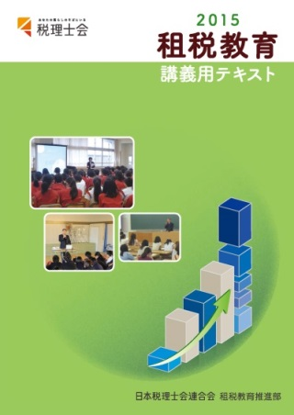
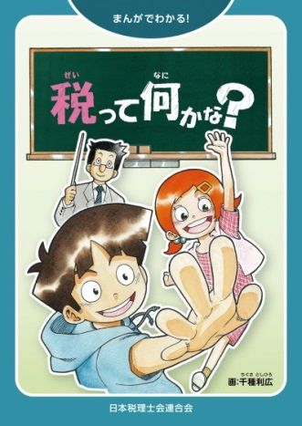
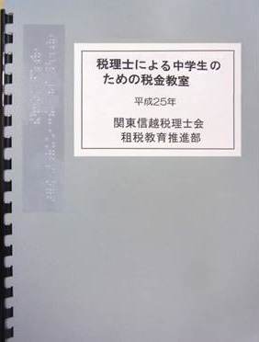
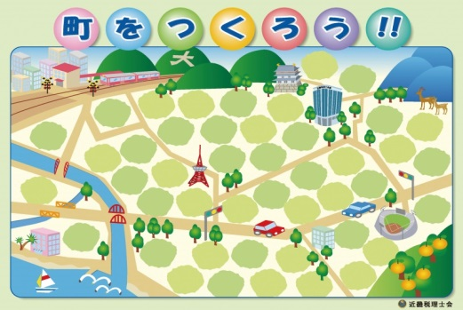
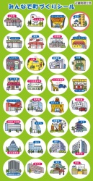
5-1 Other Activities besides Tax Classes
Original textbooks and learning kits for tax classes produced by JFCPTAA and Regional Associations
Textbook for zeirishi when teaching class
Manga for elementary and
junior high school students
Text in Braille
Cartoon
Town Building Game

Slide 13
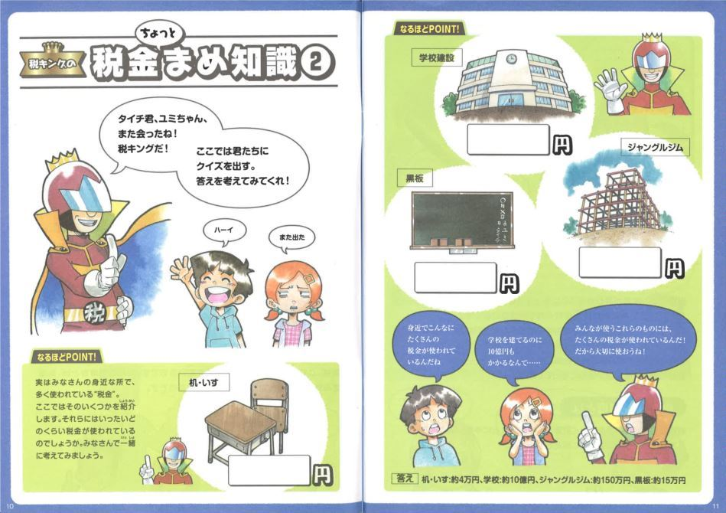
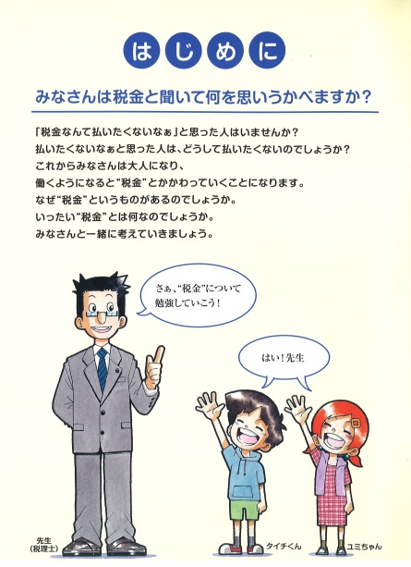
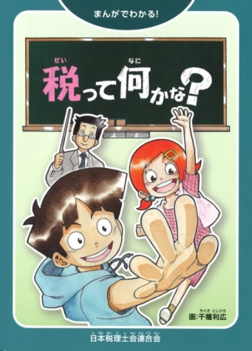
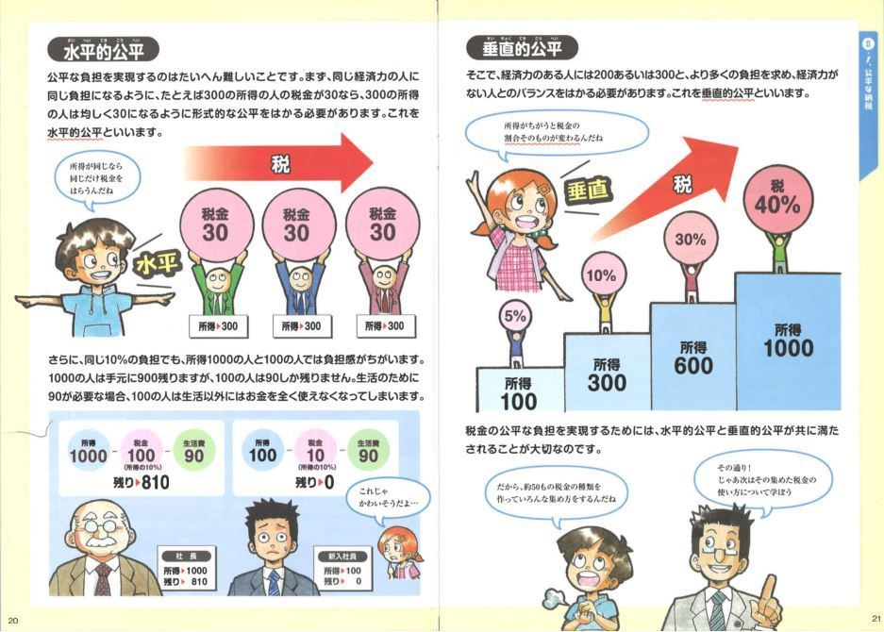
5-2 Other Activities besides Tax Classes
Explaining tax money used for various public facilities by Q&A
Textbook for zeirishi when teaching class
Manga for elementary and
junior high school students
Text in Braille
Explaining tax items and structure by using illustration
Manga book with 56 pages
Cartoon
Town Building Game

Slide 14
5-3 Other Activities besides Tax Classes
JFCPTAA and Regional Associations
Activities besides Tax Classes for Students
Sponsorship of university courses
Sponsorship of courses at universities offering degrees in education
Offering tax classes at seminars for teaching license renewal
Opinion exchanges with the relevant ministries and agency: MEXT, MIC and NTA
Liaison conferences with the Board of Education of local governments
Participation in the People’s Forum “Think about Tax”

Slide 15
6 Future Perspectives
To further fulfill taxpayer education at senior high schools and universities
Taxpayer education so that students will be taxpayers in a few years can get to know our society through taxes is highly desirable.
To revise the “Curriculum Formulation” set by MEXT and school textbooks
The present school textbooks lack explanations about the self-assessment system, the basic tax system in Japan.
In teaching tax to students, the self-assessment system should be emphasized more strongly than the obligation to pay tax from the viewpoint of sovereign.
To support teachers to engage in taxpayer education
At present, very few school teachers have a deep insight on taxes. The JFCPTAA and Regional Associations focus on supporting teachers who can teach about taxes properly.

Slide 16
Thank you.
Please enjoy a stay in Japan.

Slide 17
Country Approaches to Taxpayer Education
Country | Approach
Bangladesh | National Income Tax Day
Bhutan | Bookkeeping workshops for small businesses
Brazil | Accounting and tax support for low-income taxpayers
Burundi | Reaching the informal sector by instituting a taxpayer identification number system
Chile | Introducing online taxpayer education
Colombia | Digital signature and online declaration campaign
Costa Rica | “Tribute to my country” game room
El Salvador | Tax Education Diploma: Teaching teachers to teach tax
Estonia | E-tax/e-Customs initiative
Guatemala | “Strength lies in numbers”
Jamaica | School Taxpayer Education Program
Kenya | School Outreach Program
Korea | Tax classes for small businesses
Lebanon | Tax calendar
Source : OECD A Global Source Book on Taxpayer Education (2013)

Slide 18
Country Approaches to Taxpayer Education
County | Approach
Malaysia | Tax fun for children
Mauritius | Building a culture of compliance
Mexico | Teaching tax in higher education
Morocco | Educating children in tax compliance
Mozambique | “Together We Make Mozambique” campaign
Nigeria | Tax soap opera Building Duty
Peru | Master strategy for tax education
Rwanda | Celebrating the taxpayer
Senegal | National Information Days
Singapore | No-Filing Service
South Africa | Mobile Tax Units
Turkey | Simplifying rental income returns
Uruguay | Tax-themed computer games
Zambia | Tax Chat
Source : OECD A Global Source Book on Taxpayer Education (2013)

