Slide 1



Anti Tax Avoidance in China
Mr. Song Wei
Chief Partner
Union Power Professional Service Group
October 2013
Hanoi, Vietnam

Slide 2

Contents
1
Emergence and Evolvement of Anti Tax Avoidance in China
2
Legislations of Anti Tax Avoidance in China
3
Tendency & New Concepts of Anti Tax Avoidance in China
4
Impact of Anti Tax Avoidance on Tax Consultants

Slide 3
Emergence and Evolvement of Anti Tax Avoidance in China
Year of 1987
Year of 1991
Year of 1993
Year of 2008
Year of 2009
First local regulation concerning transfer pricing in China
Income Tax Law for Foreign Investment Enterprises
First time when transfer pricing was guidance by law
Law for Administra-tion of Tax Collection
Empower tax bureau to make reasonable adjustment
Enterprise Income Tax Law and its Implemental Regulations
Guidance for management under new EIT system
Guoshuifa [2009] NO.2
Significant and major regulation concerning anti tax avoidance in China
Theories are combined with practice gradually to improve management in Anti Tax Avoidance in power, width and depth.

Slide 4

Emergence and Evolvement of Anti Tax Avoidance in China
Anti Tax Avoidance in China is developing at a rapid speed with tax adjustment by transfer pricing increased from RMB0.68 billion in 2006 to RMB2.4 billion in 2012 and cases for transfer pricing investigation developed in quantity and quality.
China is ranked at top 3 with rigorous supervise of transfer pricing in the world, following Japan and India, according to Weekly of transfer pricing in England.
4

Slide 5
Contents
1
Emergence and Evolvement of Anti Tax Avoidance in China
2
Legislations of Anti Tax Avoidance in China
3
Tendency & New Concepts of Anti Tax Avoidance in China
4
Impact of Anti Tax Avoidance on Tax Consultants

Slide 6

Legislations of Anti Tax Avoidance in China
Existing legislations in effect
Enterprise Income Tax (“EIT”) Law
Guoshuifa [2009] NO.2
Devoted a whole chapter (Chapter 6) to stipulate administration of special tax adjustment.
Implementation Measures for special tax adjustment (Trial Version) was released
spells out in detail special tax adjustments systematically.
Guoshuifa [2009] No.698
others
Strengthening the management of Anti Tax Avoidance on equity transfer of non-resident corporations
More tax legislations for supervision

Slide 7

Legislations of Anti Tax Avoidance in China
Current Framework of Transfer Pricing in China
Transfer Pricing Management
General Anti-tax Avoidance Rule
Advance Pricing Arrangement
Anti Tax Avoidance in China
Thin Capitalization
Cost Sharing Agreement
Controlled Foreign Corporation
7

Slide 8
Transfer Pricing (“TP”) Management
“Transfer Pricing Management" shall mean that taxation authorities examine, evaluate and investigate whether transactions between enterprises and their related parties are conducted according to the arm's length principle, and make the relevant tax adjustments.
PRC Resident Enterprises with calculation of profit at actual basis
NON-PRC residence with PE and calculation of profit at actual basis
Related Party Transaction
(“RPT”)
Regular management
  Annual reporting of related-party transaction with submission of RPT Form. apply for all the above enterprises
  Contemporaneous Documents regarding RPT. apply for part of the above enterprises met criteria
TP audit
  TP report;
  Semi-automatically collect related data to analysis from annual tax filing; and
  Select traditional industry occasionally.
8

Slide 9
Advance Pricing Arrangement ("APA")
An enterprise may reach an APA with taxation authority on
pricing policies and calculation methods for its related party transactions. PRC tax authority is encouraging competent enterprises to apply for APA.
Type of APA | Unilaterally; Bilaterally; and Multilaterally
Enterprise scope for APA | Meet all of the following criteria: (1) Annual RPT volume exceeding RMB 40 million; (2) Having performed the obligation of RPT filing; and (3) Having prepared, maintained, and submitted Contemporaneous Documents regarding RPT.
Effective period of APA | 3~5 years
9
9

Slide 10
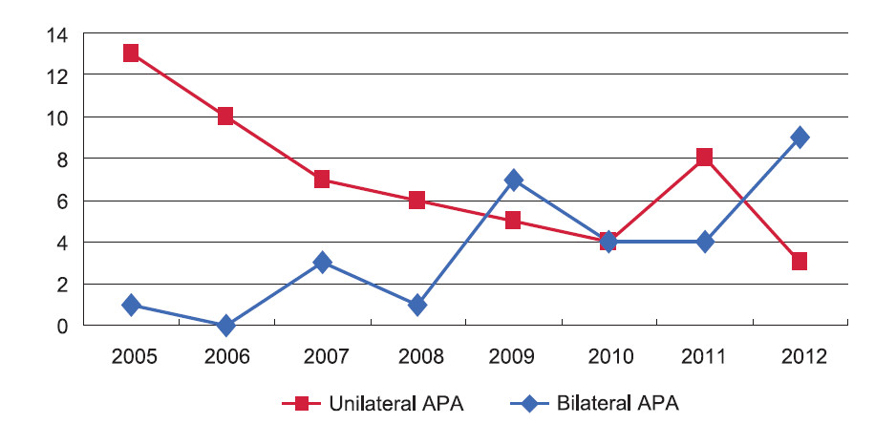
Advance Pricing Arrangement ("APA")
Data source: China Advance Pricing Arrangement Annual Report (2012)
10

Slide 11
Cost Sharing Agreement (“CSA”)
Intangible assets:
Joint development; and
Joint acceptance.
Service:
group procurement; and
group marketing planning activities.
Principle:
Arm's length principle
Costs commensuration with the expected benefits
CSA
Enterprises shall report to the PRC State Administration of Taxation within 30 days after reaching the CSAs and State Administration of Taxation will review on whether the CSA complies with the arm's length principle. How to balance costs with the expected benefits will be a focus point during the review process.
11

Slide 12
Controlled Foreign Corporation（“CFC”)
Control:
(1) ≥10% of a foreign enterprise's voting shares, or
jointly ≥ 50% of that foreign enterprise's shares;
(2) An effective control by virtue of shares, capital, business operations, purchases and sales, etc.
Taxable region:
in a country (or region) with the actual tax rate at lower than 12.5%
Refuse or reduce of profit distribution:
Without reasonable business needs
Deemed as Profit Distribution
12

Slide 13
Thin Capitalization (“TC”)
Since loan interest can be deductive from taxable enterprise income, while dividends by share capital shall be distributed after enterprise income tax only when the enterprise achieves profit, enterprises prefer to adopt loan capital rather than share capital for the tax shield advantage of interest. When the loan to equity ratio is far beyond normal, the problem of thin capitalization comes.
Interest expense raised by loan from related party exceeding standard ratio of Related Party Loan to Equity Ratio is non-deductable before Enterprise Income Tax
Unless meet the below criteria:
the enterprise can provide documentation to prove the loans were entered into based on the arm’s-length principle
the effective interest rate of the borrowing enterprise does not exceed the effective interest rate of the domestic lending enterprise
Standard ratio:
Financial institutions
Related Party Loan to Equity Ratio = 5:1
Non Financial enterprise
Related Party Loan to Equity Ratio = 2:1
13

Slide 14

General Anti-tax Avoidance Rule (“GAAR”)
The cause when launch a GAAP
  Abuse of tax incentive policies
  Abuse of tax treaty
  Abuse of organization structure
  Tax avoidance by means of tax heavens
  Running business without reasonable basis
Focus and principle
  Substance over form
  Deny the existence of shade company
  Identification of the reasonable business purposes
  Fully administrations
14

Slide 15
Contents
1
Emergence and Evolvement of Anti Tax Avoidance in China
2
Legislations of Anti Tax Avoidance in China
3
Tendency & New Concepts of Anti Tax Avoidance in China
4
Impact of Anti Tax Avoidance on Tax Consultants

Slide 16


Tendency & New Concepts of Anti Tax Avoidance in China
Broadening the scope of Anti Tax Avoidance
Scope
Focus
Transaction
Geography
Administration
Foreign investment enterprises
Focused on manufacturing & processing industries
Purchase and sale of tangible assets
Southeast coastal area
TP, APA
Enterprises covering domestic enterprises
“going aboard” company
Tertiary industries such as financial and trade service
Equity and intangible asset transfers & financing activities
Central and western region
CSA , CFC, TC and GAAP
16

Slide 17
Tendency & New Concepts of Anti Tax Avoidance in China
Cost Saving
Multinational company sets up its operations in China with lower expenditure
Contract Research & Development(“R&D”)
Reputation by Marketing activity
R&D corporation established in China has no ownership with the results legally and economically and it calculate profit in cost plus methods to make less profits .
Contribution to reputation of brands by Sales Corporations established in China turns in extra profits.
New Concepts
The additional profit derived by a multinational company by operating in China with unique qualities impacting on the sale and demand of a service or product
Market Premium
17

Slide 18
Contents
1
Emergence and Evolvement of Anti Tax Avoidance in China
2
Legislations of Anti Tax Avoidance in China
3
Tendency & New Concepts of Anti Tax Avoidance in China
4
Impact of Anti Tax Avoidance on Tax Consultants

Slide 19
Impact of Anti Tax Avoidance on Tax Consultants
Challenges:
Service for taxpayer
Focus not only on financial and tax compliance, but also its risk and function, orientation, industry environment and etc.
More comprehensive analytical ability
Wider range of knowledge
Challenge from tax authorities
Deeper analysis on tax legislation
Familiarity on international anti tax avoidance legislation
Better communication skills and negotiation ability

Slide 20
Impact of Anti Tax Avoidance on Tax Consultants
Opportunities:
The business of Anti Tax Avoidance for Tax Consultants was mainly focused on big 4 before;
With more systemic tax legislation of Anti Tax Avoidance in China, local firms have been taking a role on assistance of Anti Tax Avoidance and providing professional service to tax payer; and
Local firms shall draw more attention on practice and training of Anti Tax Avoidance.

Slide 21


Thank you !

