Slide 1
TAXPAYER CHARTER PROJECT
Presented By:
Michael Cadesky
David Russell
for AOTCA 2015 Conference

Slide 2
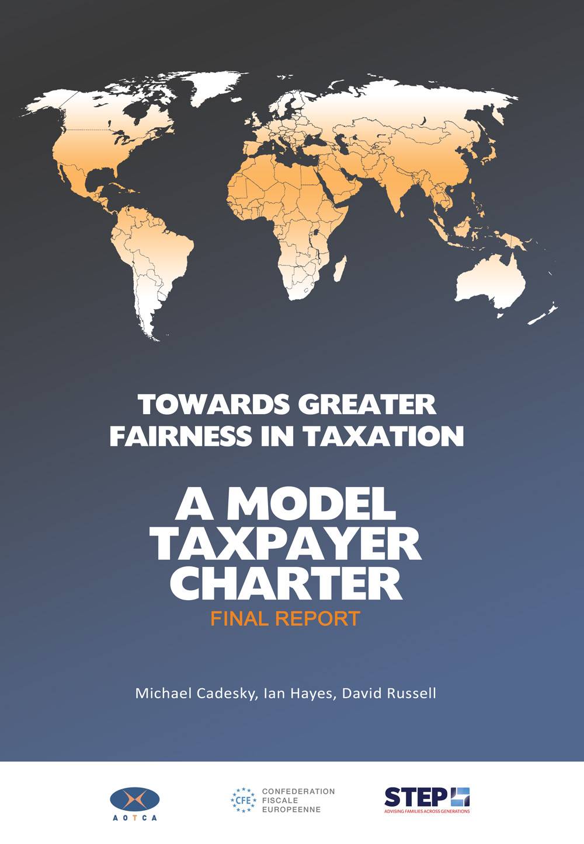

Slide 3
Taxpayer Charter Project
Origins of the Project
Collaboration of Organizations
Study Methodology
Model Charter
Web Site
What Comes Next

Slide 4
Origins of the Project
Increased compliance burden
Increased complexity of legislation
Increased uncertainty in tax matters
Taxpayer Responsibilities:

Slide 5
Origins of the Project
Taxpayer Rights:
Increasingly limited
Little progress
No agreed on standard across the world
No unified voice
No legal force

Slide 6
Collaboration of Organizations
CFE – Europe
AOTCA – Asia Pacific
STEP – Worldwide
500,000 tax advisors
50 countries
75% of world GDP

Slide 7
WORLDWIDE COVERAGE
STEP | 20,000
CFE | 180,000
AOTCA | 330,000
Total Membership: over 500,000 worldwide (combined)

Slide 8
OVERLAP OF INTERESTS
CFE
AOTCA
STEP

Slide 9
Committee of 9 people
CFE/AOTCA/STEP
Authors – 3 persons CFE/AOTCA/STEP
CFE – Ian Hayes
AOTCA – David Russell
STEP – Michael Cadesky
Website
Support staff – research
– editorial

Slide 10
Study Methodology
Library of Research Materials
Compiled Extensive Survey
41 Countries Responded
164 Questions
Over 6,500 Answers

Slide 11
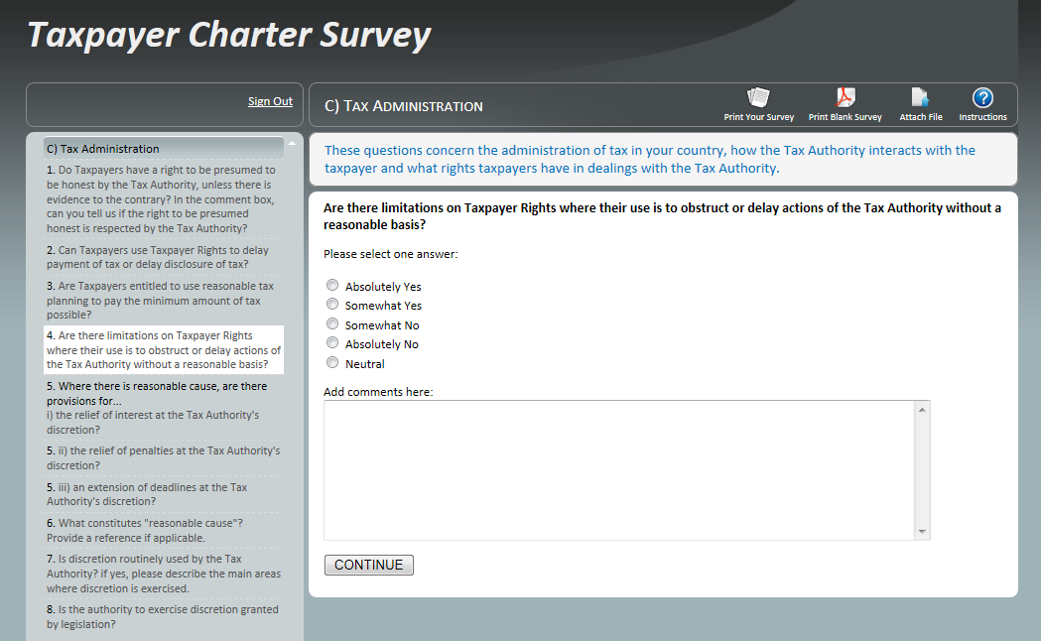
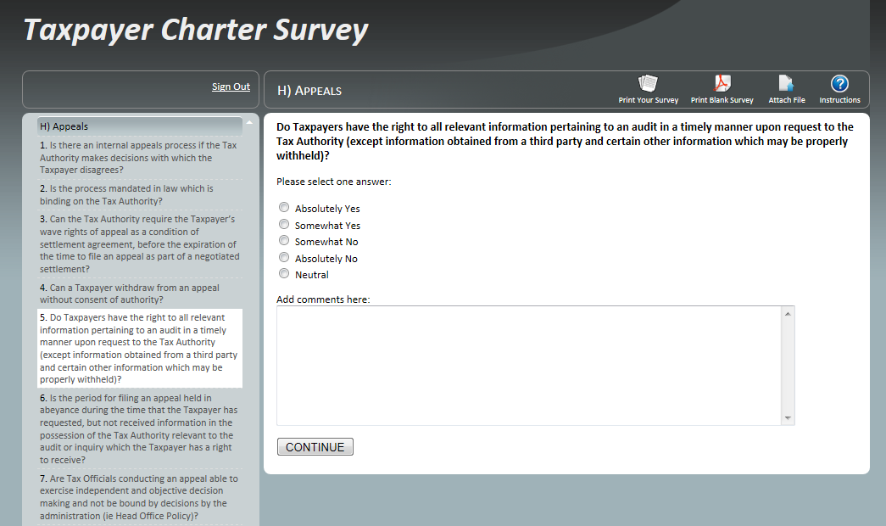

Slide 12
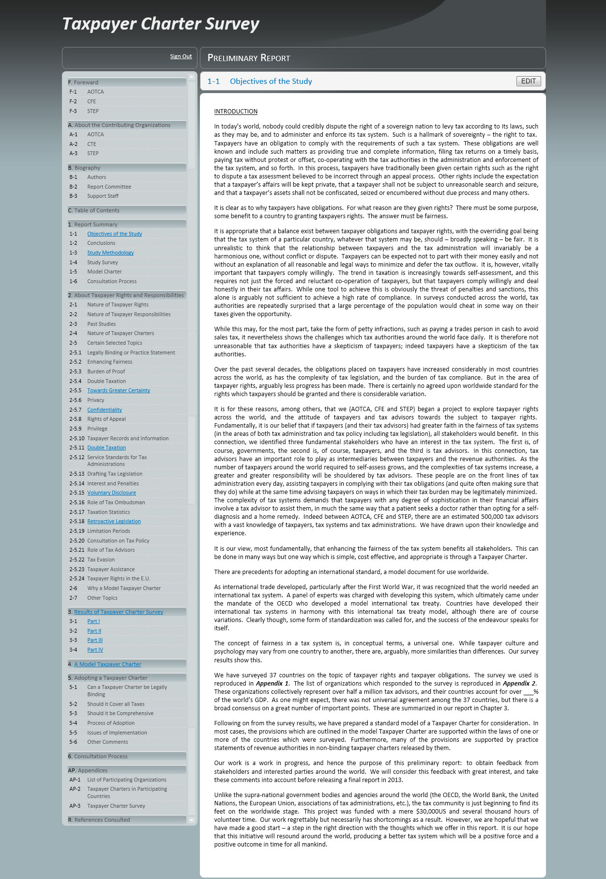

Slide 13
Model Charter Developed
Refined by Survey Results
Test of Validity (Charter ⬅➔ Survey)

Slide 14
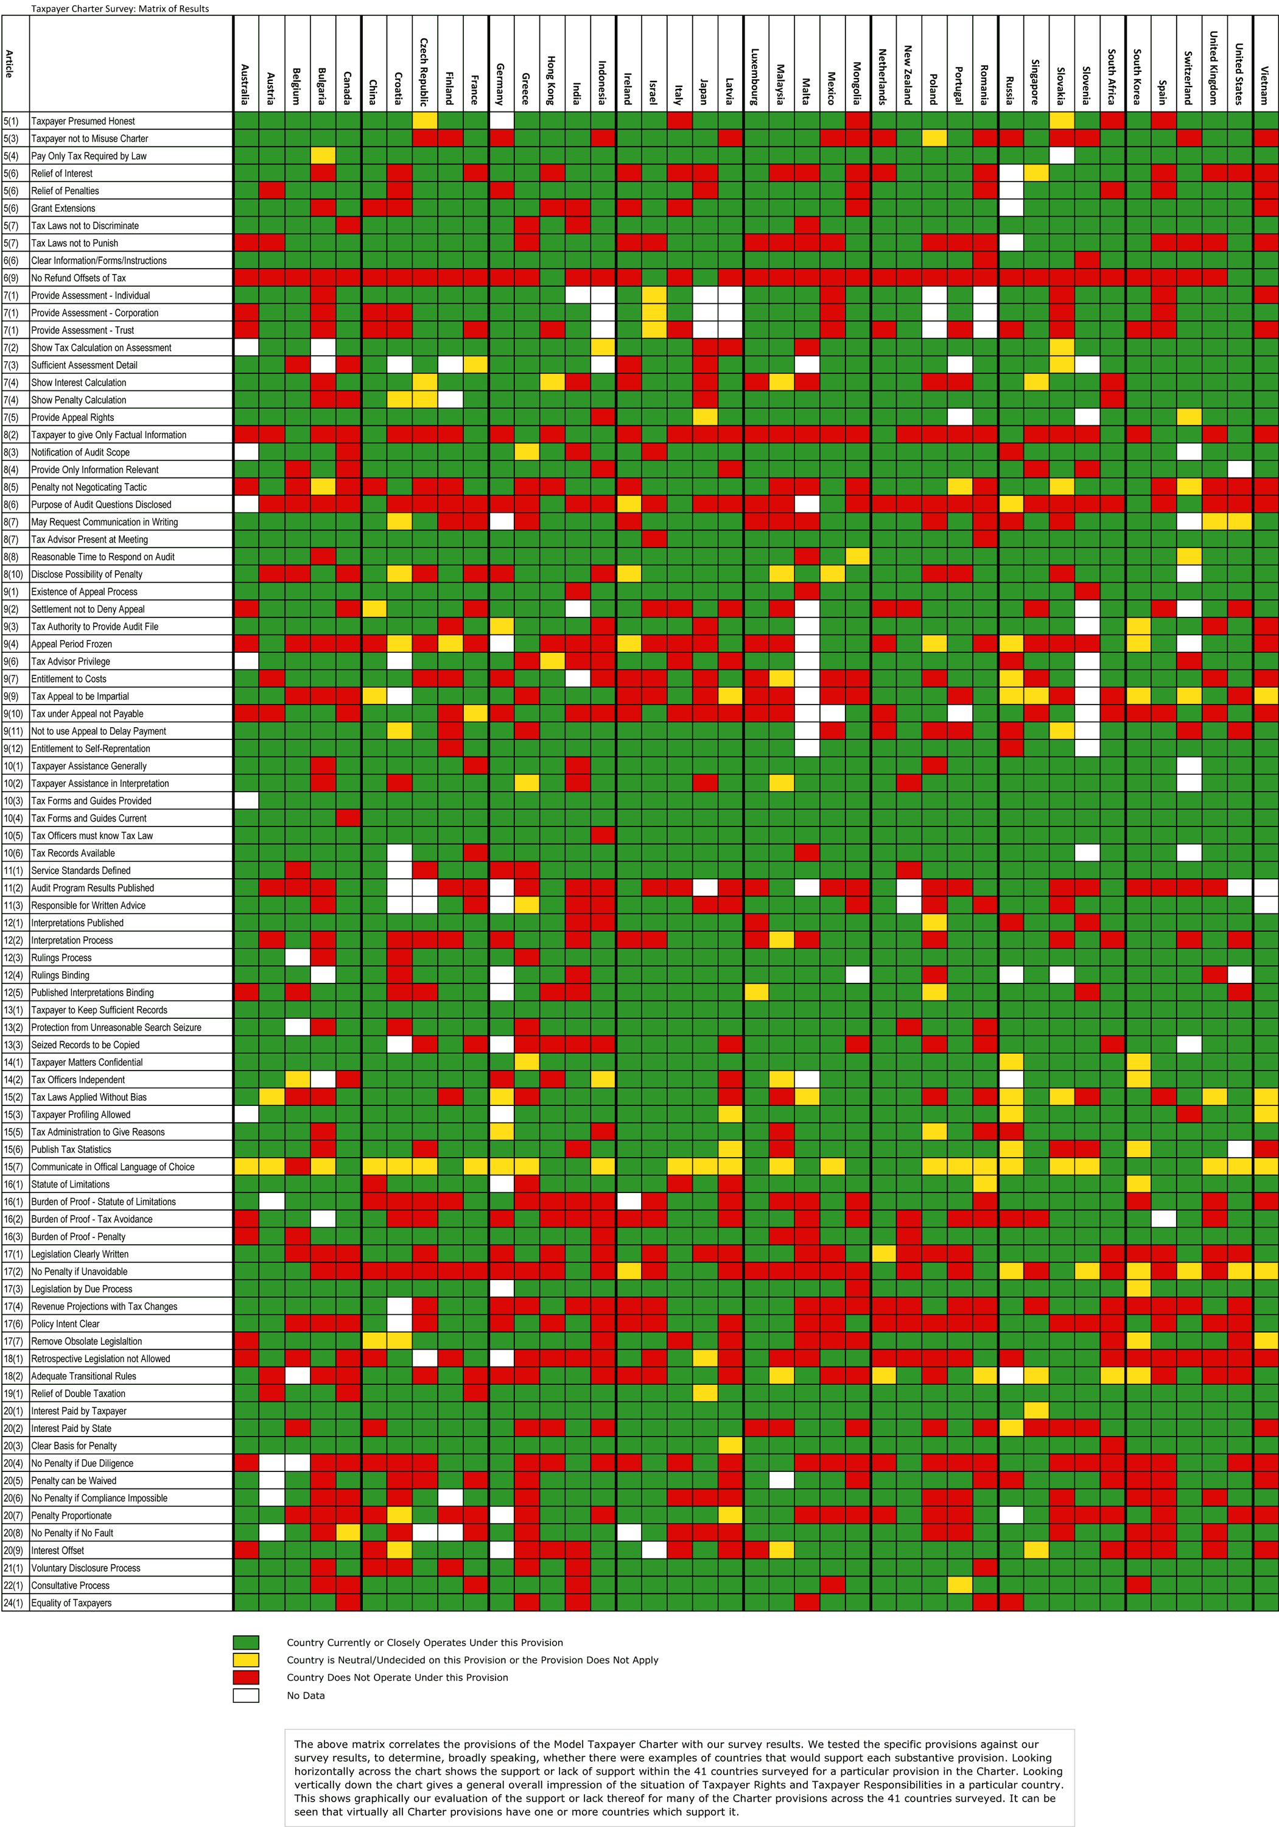

Slide 15
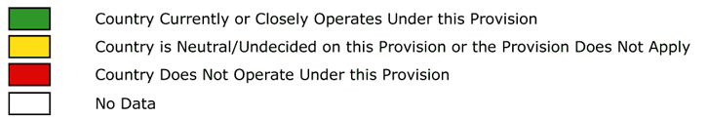

Slide 16
Preliminary Report
Length – 200 pages
Form – soft cover book
Distribution – Finance and Revenue
Ministers, Commissioners, Deputies
in 37 countries
– OECD
– E.U. Parliament
– United Nations
– IMF
– World Bank
– AOTCA/CFE/STEP
– Media

Slide 17
Visits
E.U. Parliamentary Committee on Taxpayer Code
OECD (Pascal Saint-Amans)
UN (Committee of Experts on International Cooperation in Tax Matters)

Slide 18
Feedback
OECD Letter - should be principles based
- tax advisors should have more responsibilities
- should consider enhanced relationship
- uses old fashioned confrontational approach to tax administration
Certain Countries - U.K.
- Indonesia

Slide 19
Final Report
Final Report
Guiding Principles at the Beginning
Expanded Provisions on Tax Advisors
But otherwise similar
Now complete

Slide 20
Final Report
Principles
Rights of taxpayer [Responsibility for tax administration]
Duties of taxpayer [Rights of tax administration]

Slide 21
Final Report
20 Principles
Taxpayer Rights
1. Integrity and equality | The Tax system shall be designed and administered fairly, honestly and with integrity, according to the law, without bias or preference.
2. Certainty | The Tax system will be designed and administered to provide as far possible certainty, clarity and finality in one’s Tax affairs.
3. Efficiency and effectiveness | The Tax system will be designed and administered fairly and cost effectively taking into account the attainment of its purposes.
4. Appeal and the right to dispute resolution | In cases of disputes as to Tax liability an independent, objective, speedy and cost effective appeal process. Disputes as to actions of the Tax Authority will be followed up without fear of reprisal under independent oversight.

Slide 22
Final Report
20 Principles
Taxpayer Rights
5. Appropriate assistance | Taxpayers who face difficulties in carrying out their responsibilities as Taxpayers will be given appropriate assistance by the Tax Administration.
6. Confidentiality and privacy | A Taxpayer’s affairs and records will be kept confidential and private except in the case of public hearings in litigation or criminal prosecutions.
7. Pay correct amount of Tax | A Taxpayer is required to pay no more than the amount of Tax based on Tax laws.
8. Representation | A Taxpayer may be represented by a person of the Taxpayer’s choosing.
9. Proportionality | Enforcement action including audits, collections, reassessment, penalties and prosecutions will be proportionate to the circumstances.
10. Honesty | In the absence of any evidence to the contrary to be presumed honest.

Slide 23
Final Report
20 Principles
Tax Responsibilities
1. Be truthful | Be truthful in all Tax matters including legally required disclosures.
2. Provide information | Provide information on a timely basis as and when reasonably required.
3. Be cooperative | Be cooperative in dealings with the Tax Administration, filing Tax returns and information reporting, the conduct of an audit, and payment of Taxes.
4. Make payment | Pay Tax on time without deduction or offset subject to the right to appeal.
5. Comply with the law | Comply with Tax responsibilities and seek assistance if necessary.

Slide 24
Final Report
20 Principles
Tax Responsibilities
6. Maintain records | Maintain accurate financial records and supporting information for such period as may be reasonably required.
7. Take due care | Exercise an appropriate degree of care and diligence in taxation matters.
8. Retain responsibility for advisors | Be held accountable for the correctness and completeness of the information supplied to the Tax Administration whether or not another person has been engaged to prepare, assemble and/or submit the information on your behalf.
9. Show courtesy | Treat Tax Officers with courtesy and respect, noting that abuse of Tax Officers in performance of their duties is never acceptable.
10. Comply cross border | Ensure that all legitimate cross border compliance requirements are met.

Slide 25
Final Report
Table of Contents
Article 1. Introduction and Purpose
Article 2. Definitions
Article 3. Who and what is covered?
Article 4. Fundamental Principles
Article 5. General Provisions
Article 6. Filing of Tax and Information Returns
Article 7. Assessment Process
Article 8. Audit Process
Article 9. Appeals Process
Article 10. Taxpayer Assistance
Article 11. Service Standards
Article 12. Rulings and Interpretations

Slide 26
Final Report
Table of Contents
Article 13. Taxpayer Records
Article 14. Privacy and Confidentiality
Article 15. Tax Administration Generally
Article 16. Burden of Proof
Article 17. Tax Legislation
Article 18. Retroactivity of Legislation
Article 19. Double Taxation and Relief
Article 20. Interest and Penalties
Article 21. Voluntary Disclosure
Article 22. Legislative Process and Consultation
Article 23. Tax Levied Only by Virtue of Law
Article 24. Equality of Taxpayers
Article 25. Vulnerable Persons

Slide 27
Final Report
Table of Contents
Article 26. Complaints
Article 27. Matters Concerning Tax Advisors
Article 28. Breach of Charter Rights
Article 29. Enforcement and Collection of Tax, Interest and Penalties
Article 30. Tax Avoidance
Article 31. Tax Evasion and Dishonesty
Article 32. Corruption
Article 33. Special European Union Provisions
Article 34. Enabling Legislation
Article 35. Implementation and Transition Issues
Article 36. Amendments to Charter
Article 37. Concluding Matter

Slide 28
Final Report
Important Issues
Issue | Resolution
Should Charter have legal force? | Yes. Rights that cannot be enforced have no value.
Taxpayers protected by constitution? | Note enough. Too hard to enforce constitutional rights and not focussed enough to be practical.
Why have a worldwide standard? | Across the world tax systems and administration have similarities.
What’s wrong with existing Taxpayer Charters? | Not comprehensive Rarely holds tax authority accountable Not legally bindings Does not consider tax policy and legislation
What benefits are there to governments? | Happier taxpayers are more compliant taxpayers Fairness perception is powerful System overall will work better

Slide 29
Final Report
Important Issues
Issue | Resolution
How specific should a Taxpayer Charter be? | Quite specific. General statements of good intent are often just ignored. But if too specific, hard to adapt as worldwide standard. So careful balance is needed.
How can a taxpayer enforce Charter rights? | It will vary from country to country but either through a complaints system or court intervention if necessary.
Will it prevent the tax authority from carrying out its work? | The rights and responsibilities are balanced. Implemented properly a Taxpayer Charter should assist the tax administration in its work in many areas.
Why would a tax authority give up rights? | Because of the taxpayer cooperation expected in return

Slide 30
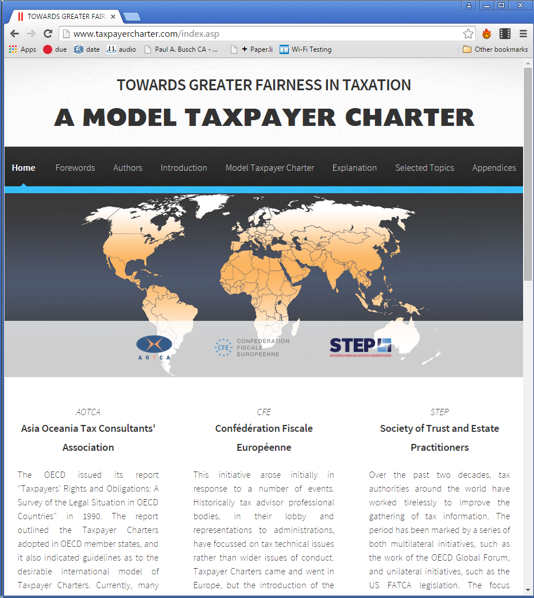
Web Site
www.taxpayercharter.com

Slide 31
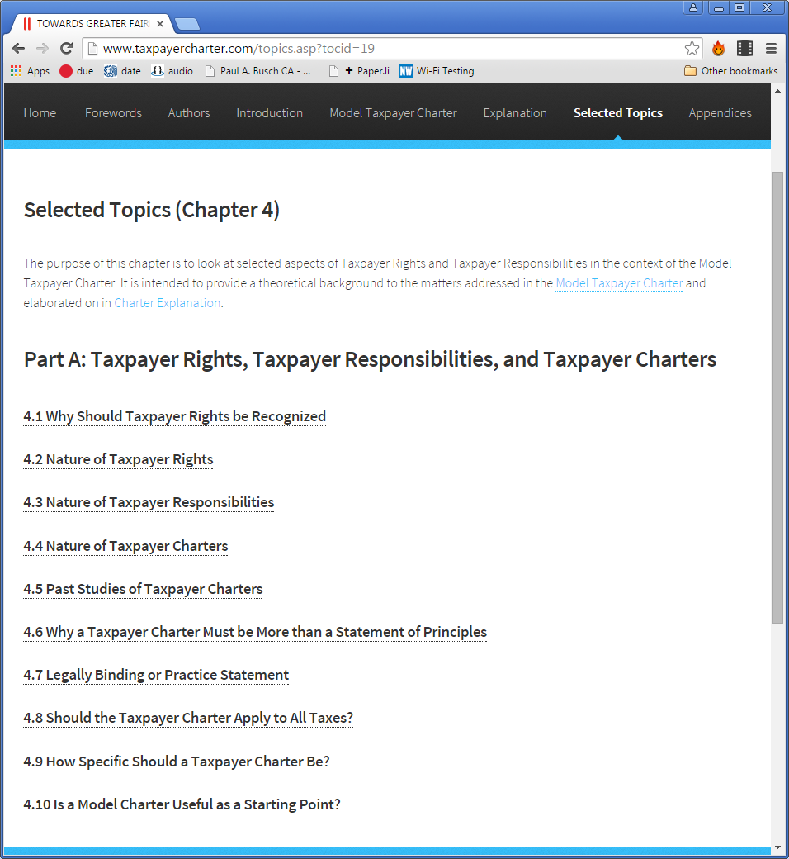
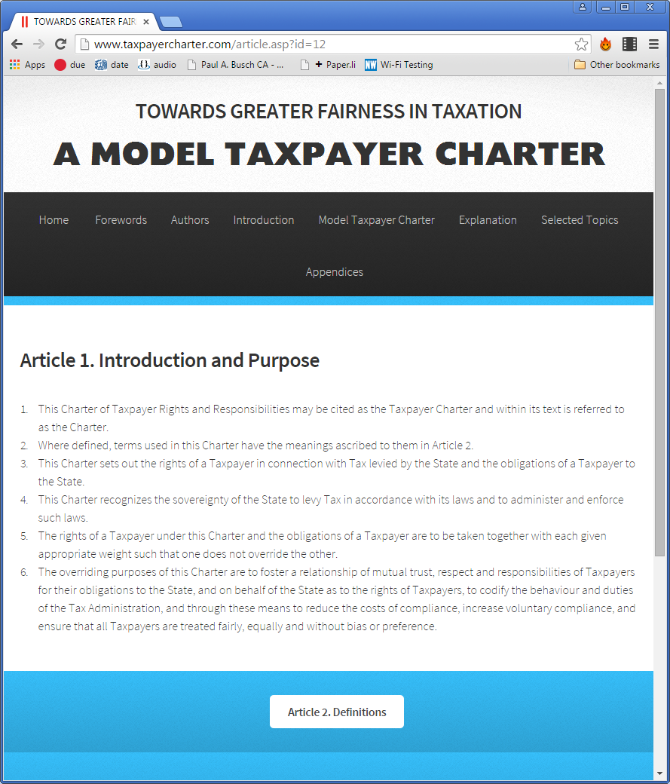
Web Site
www.taxpayercharter.com

Slide 32
Final Report - Distribution
Publish in book form (200 pages)
Publish on web site (400 pages)
Prepare a summary (16-20 pages)
Translation
Finding an adoption partner
Conference to study the provisions (possible March 2016)

Slide 33
End Goals
Adoption as worldwide standard
Give Tax Profession a Worldwide voice
Improve Relationships between Taxpayers, Tax advisors and Tax Administrations
Global Forum of Tax Advisors

