Slide 1


Vietnam’s New Tax Incentive Regime
Benefits & Limitations
AOTCA 2013 Tax Conference
Hanoi, 17 October 2013
Nam Nguyen
Partner, Tax & Corporate Services
namnguyen@kpmg.com.vn

Slide 2
Presentation outline
    Country overview – Foreign Direct Investment
    What attracts foreign investors to Vietnam
    Vietnam’s new tax incentive regime - Benefits
    Vietnam’s tax incentive regime – Limitations
    Common issues

Slide 3
Country Overview – Foreign Direct Investment
Registered foreign direct investment
Source: General Statistics Office, and Foreign Investment Agency – Ministry of Planning and Investment
    FDI has been critical to Vietnam’s economic success over the last two decades
    The Government has recognised this over time by providing attractive tax incentives to both domestic and foreign investors
Notes:
FDI over the last 3 years were decreased due to economic difficulties
However, disbursement rate improves -> which shows the confidence of foreign investors in Vietnam
FDI not only flows into export processing industries but also into high value-added services, high technology and energy-saving industries

Slide 4
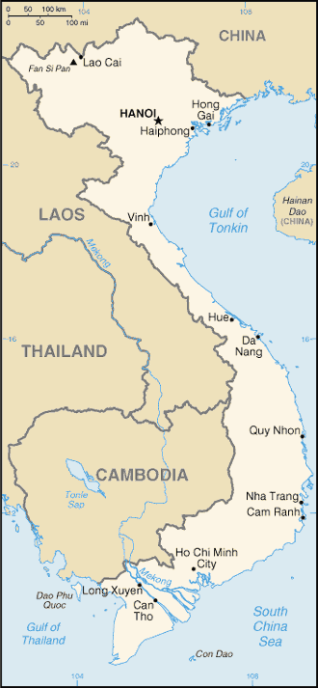
What attracts foreign investors to Vietnam?
Political stability and safety
China + 1 policy (investment diversification); key to other ASEAN markets
A thriving market and economy of over 90 million consumers with steadily rising level of income;
A young, literate (95%), low-cost workforce with strong work ethics;
A friendly population and entrepreneurial culture;
Abundant natural resources; significant reserves of oil& gas and minerals; beautiful coast line
A business-friendly environment (pro-business government);
Attractive tax incentives.

Slide 5
Vietnam’s New Tax incentive Regime
(Law 32/2013/QH13 effective 1 Jan 2014)
Benefits:
      Reduced tax rate of 10% for 15 years from the 1st revenue-generating year
      Tax holiday up to 4 years from the 1st year of earning taxable income
      50% tax reduction up to 9 years following the tax holiday
Requirements:
      Businesses in areas with especially difficult socio- economic conditions, economic zones, high-tech zones
      Promoted sectors including (but not limited to) hi-tech research, development, and application; crucial infrastructure projects; production of software, composite materials, light building materials, rare materials, renewable energy; development of bio-technology, environment protection projects etc.
Manufacturers who meet one of the two criteria below:
Invest at least VND6,000 billion within the 1st three years following the issue of business license, and achieve at least VND10,000 billion revenue within the 1st three revenue-generating years; or
Invest at least VND6,000 billion within the 1st three years and employ more than 3,000 workers

Slide 6
Vietnam’s New Tax Incentive Regime
(Law 32/2013/QH13 effective 1 Jan 2014)
Benefits:
      Reduced tax rate of 10% for the entire life of the business
      Tax holiday up to 4 years from the 1st year of earning taxable income
      50% tax reduction up to 9 years following the tax holiday
Requirements:
      Businesses in deregulated (or known as “socialisation”) sectors (eg healthcare, education, training, culture, sports and environment)

Slide 7
Vietnam’s New Tax Incentive Regime
(Law 32/2013/QH13 effective 1 Jan 2014)
Benefits:
      Reduced tax rate of 10% for the entire life of the business
Requirements:
      “Social housing” development;
      Specified news agencies and publishers according to the Law on Press and Law on Publishing
      Agriculture, forestry, or aquaculture businesses situated in areas of difficult socio-economic conditions; specified agriculture/aquaculture productions etc.

Slide 8
Vietnam’s New Tax incentive Regime
(Law 32/2013/QH13 effective 1 Jan 2014)
Benefits:
      Reduced tax rate of 20% for 10 years from the1st revenue-generating year
      Tax holiday up to 2 years from the 1st year of earning taxable income
      50% tax reduction up to 4 years following the tax holiday
Requirement:
      Businesses situated in areas with difficult socio-economic conditions

Slide 9
Vietnam’s New Tax Incentive Regime
(Law 32/2013/QH13 effective 1 Jan 2014)
Benefits:
      Reduced tax rate of 20% (17% effective1 Jan 2016) for 10 years from the 1st revenue-generating year
      Tax holiday up to 2 years from 1st year of earning taxable income
      50% tax reduction up to 4 years following the tax holiday
Requirements:
      Production of: high-grade steels, energy-saving products; machinery and equipment servicing agriculture, forestry, aquaculture; salt; irrigation equipment; feeds for livestock, poultry or aquatic organism; promotion of traditional trades.

Slide 10
Vietnam’s New Tax Incentive Regime
Expansion of Business (effective 1 Jan 2014)
Benefits:
      The same residual tax incentives to be applied to income generated from expansion; or
      Alternative tax holiday and/or tax reduction to be applied to income generated from the expansion, subject to geographical areas and type of business
Requirements:
      Expansion of production lines, production capacity, technology or business scope that qualify tax incentives and satisfies one of the three conditions below:
        Increase in fixed assets at least by VND20 billion (or VND10 billion for businesses situated in areas of difficult/especially difficult socio-economic conditions); or
        Fixed assets have increased by at least 20%; or
        Production capacity has increased by at least 20%.

Slide 11
Vietnam’s Tax Incentive Regime
Limitations
5-year continuing loss carry-forward:
3-year continuing loss-making limit – Tax holiday must commence on the 4th year (ie. the tax incentives cannot be preserved or carried forward )
5- year loss carry-forward limit
2009
2012
2014
2016
9-year of 50% tax reduction
2025
Established
4-year tax holiday
5-year loss carry-forward limit
2009
2012
2016
2018
9-year 50% tax reduction
2025
Established
4-year exemption

Slide 12
Vietnam’s Tax Incentive Regime
Limitations
Tax incentives can not be preserved – once tax holiday is triggered it must be applied continuously and followed by the tax reduction period (ie. no leapfrogging or alternating options)
Tax incentives for expansion of business are not applicable to expansion of business resulted from or being part of M&A transactions
15% cap on tax deductibility of A&P expenses - Effective tax rate may be distorted

Slide 13
Vietnam’s Tax Incentive Regime
Common issues
Tax incentives granted in investment license vs conditions prescribed by tax law – Failing to satisfy conditions prescribed by tax laws may result in forfeiture of tax incentives;
Distinctions between ordinary income and “other income” – while most tax incentives are granted to the “entity”, they may not be applicable to income from activities falling outside the licensed scope of business;
Ascertaining “income from business/investment expansion” can be problematic – due to lack of clear formula to determine it
Criteria for high-tech sector, R&D activities.

Slide 14
Thank you
Nam Nguyen
Partner - Tax & Corporate Services
Tel: + 84 (8) 3821 9266 ext. 8199
E-mail: namnguyen@kpmg.com.vn

